Slide 1
CQRS + Event Sourcing
Antonio Venditti
Solution Architect @ Blexin s.r.l.
antonio.venditti@blexin.com

Slide 2
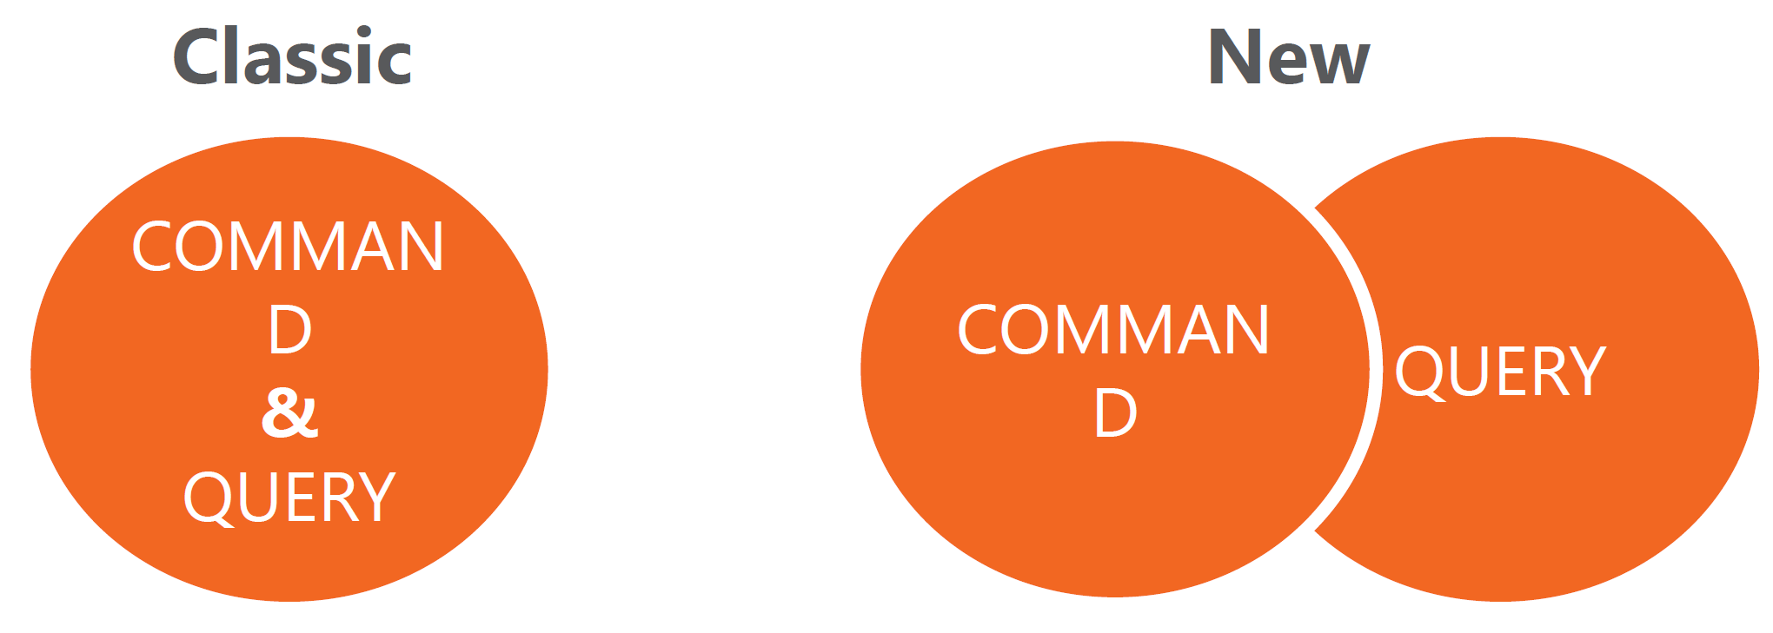
Introducing CQRS
Notes:
Eric Evan introduce DDD
Complessità del modello
Semplicazione della individuazione del modello

Slide 3
Misconception
Un unico modello per il dominio di business

Slide 4
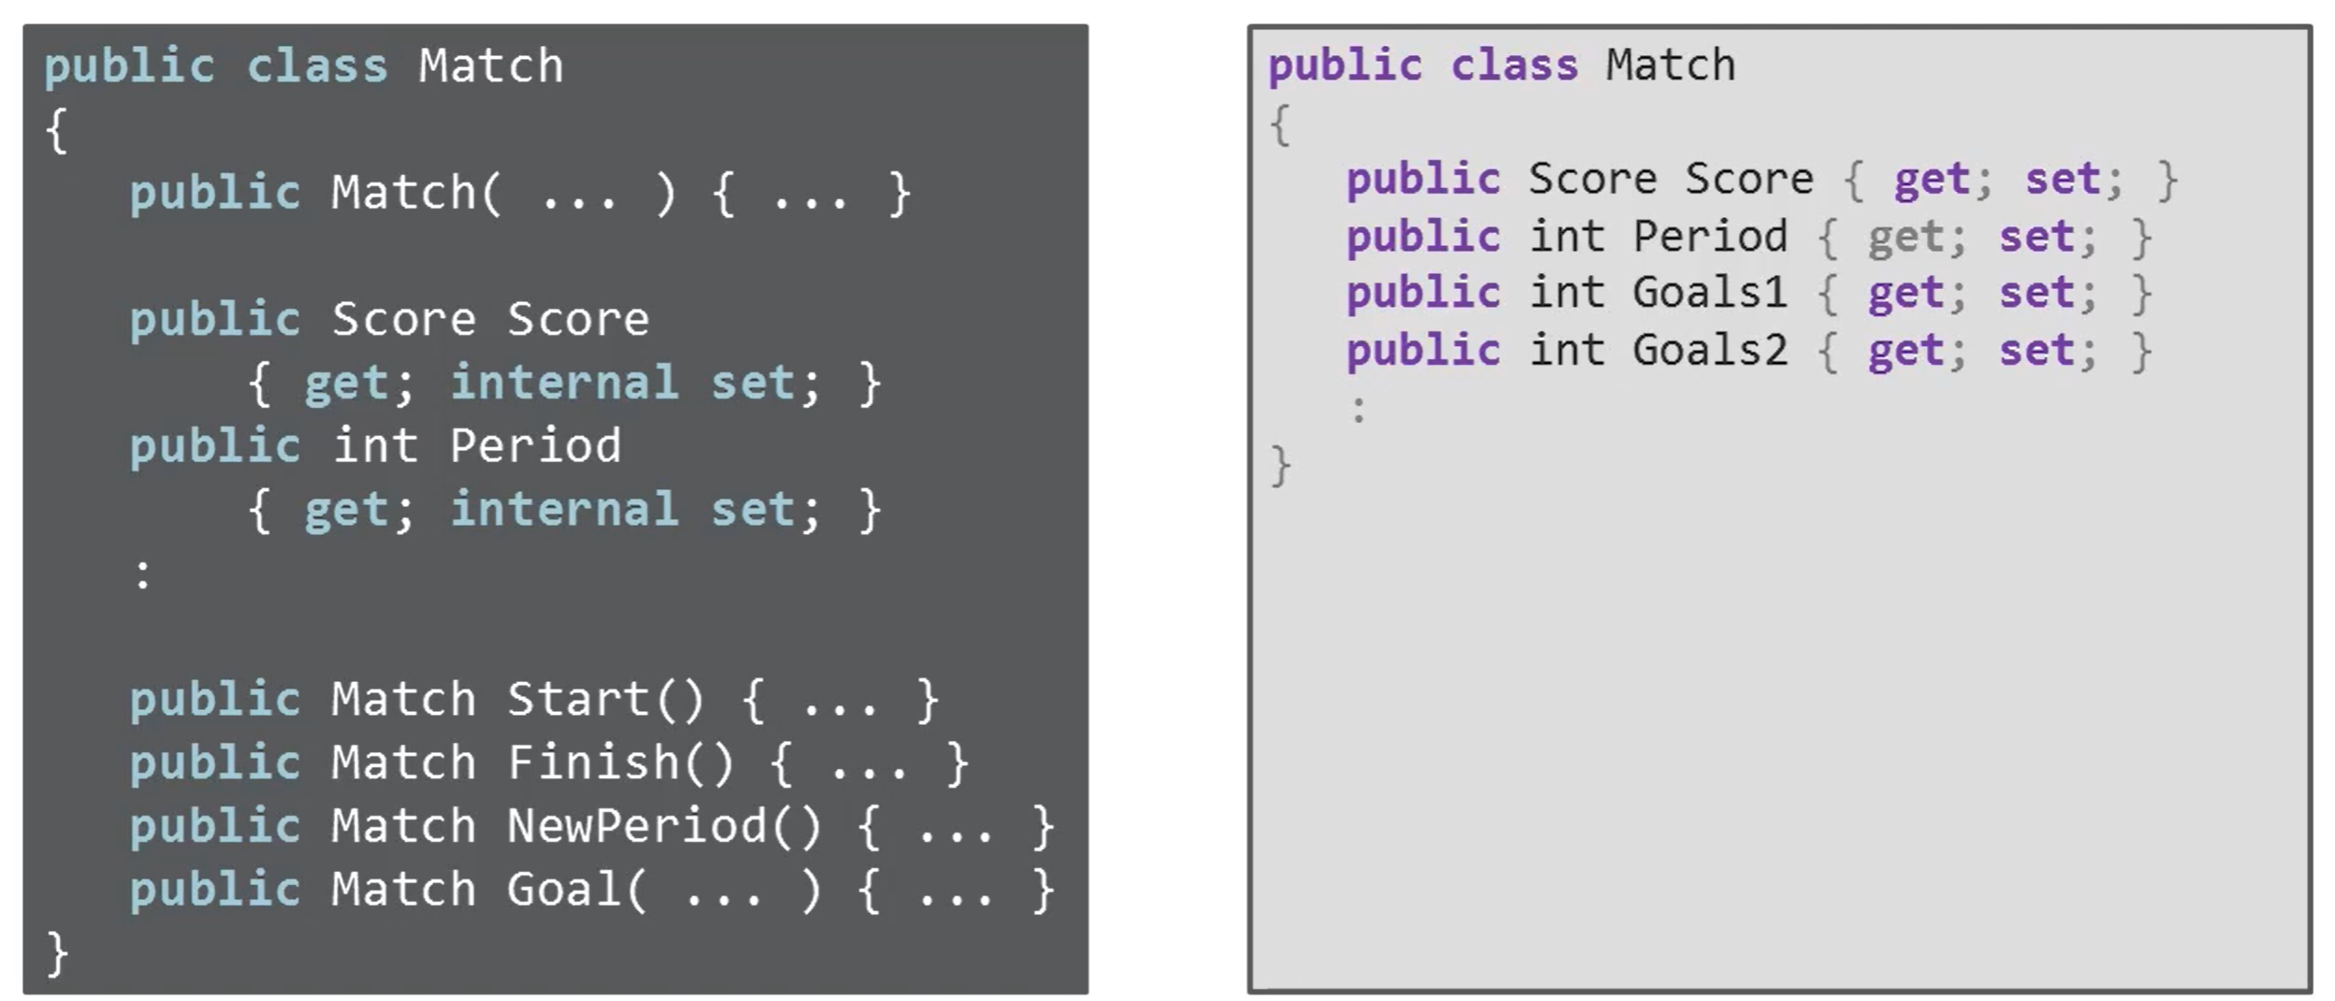
Singolo Model

Slide 5
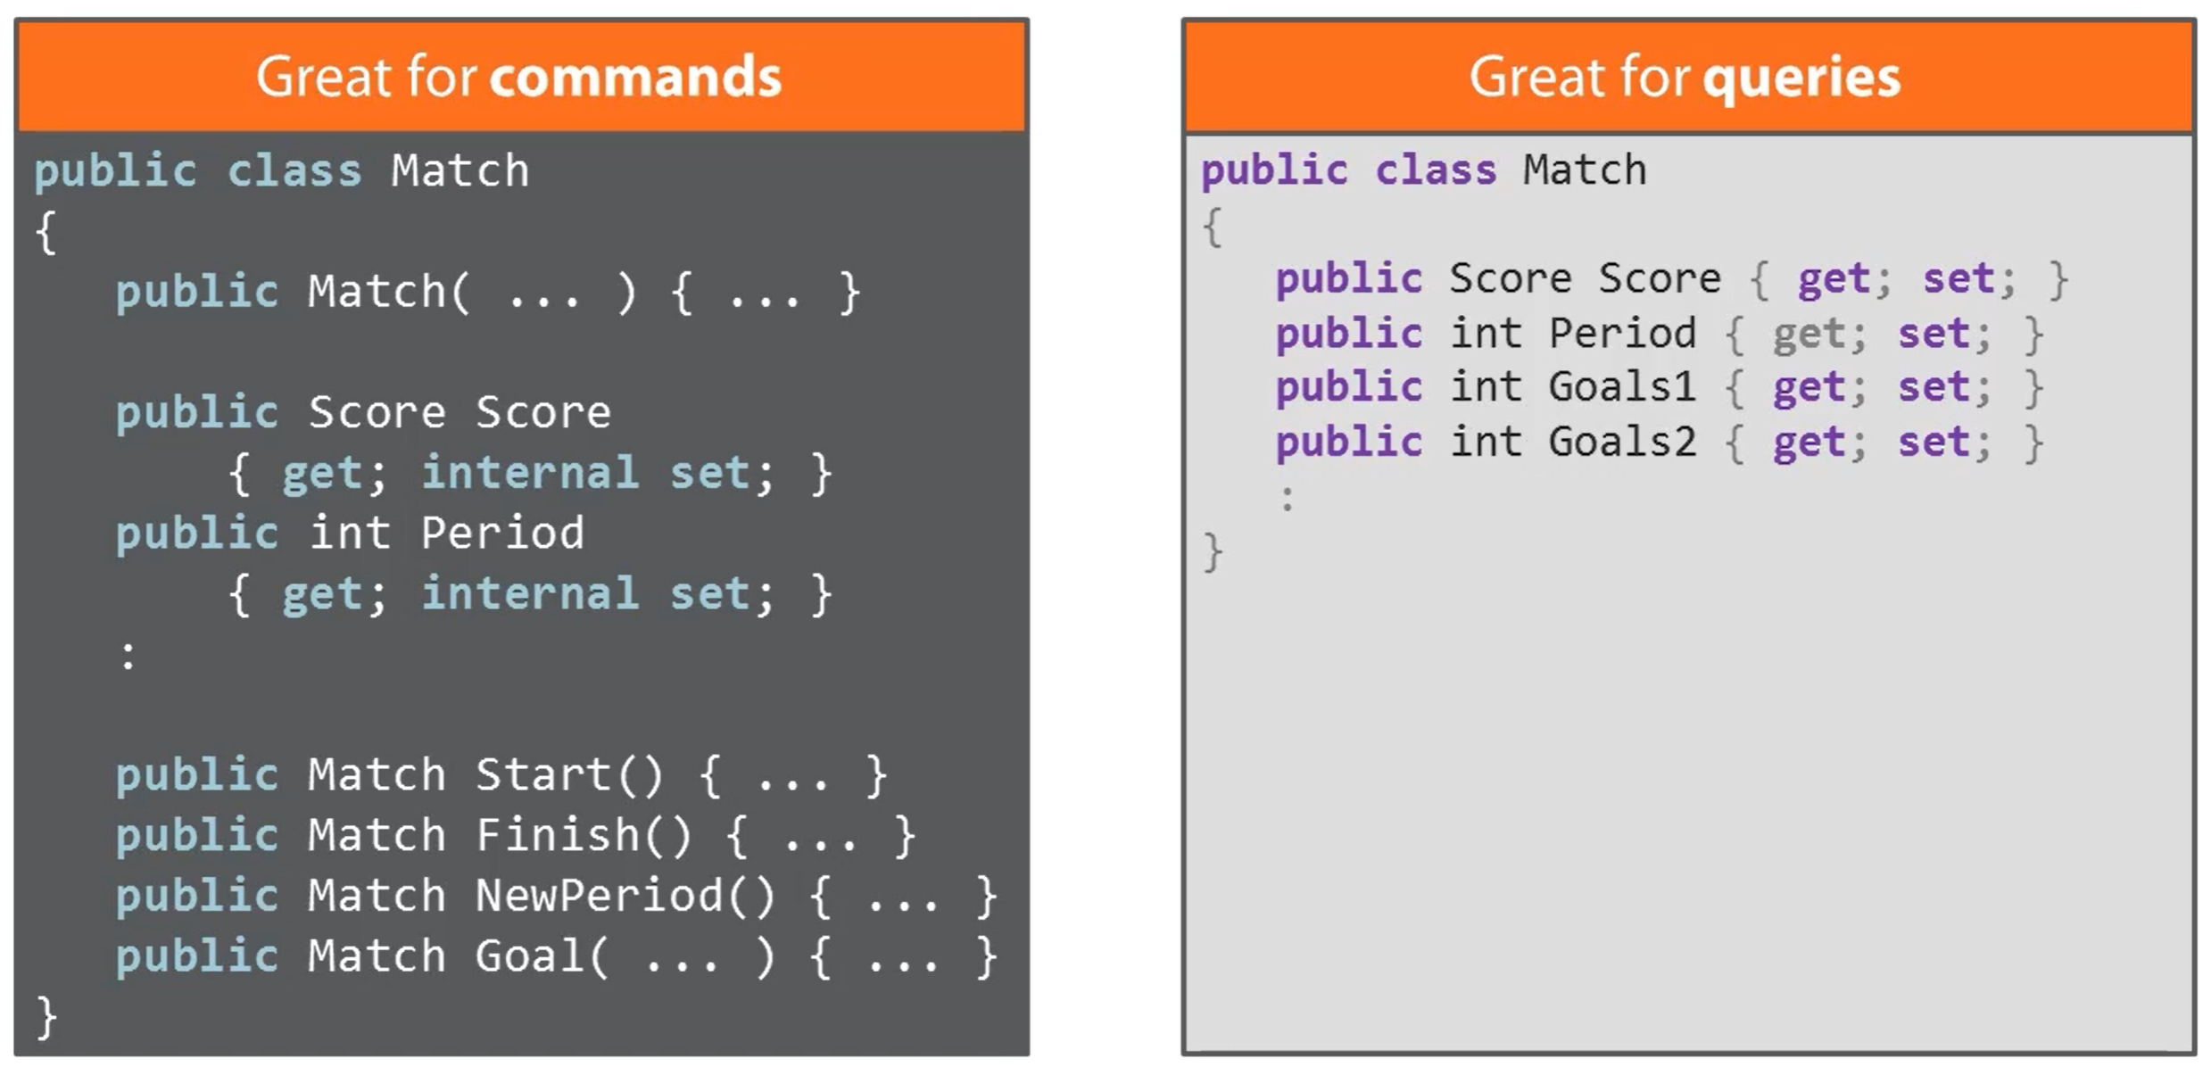
Singolo Model

Slide 6
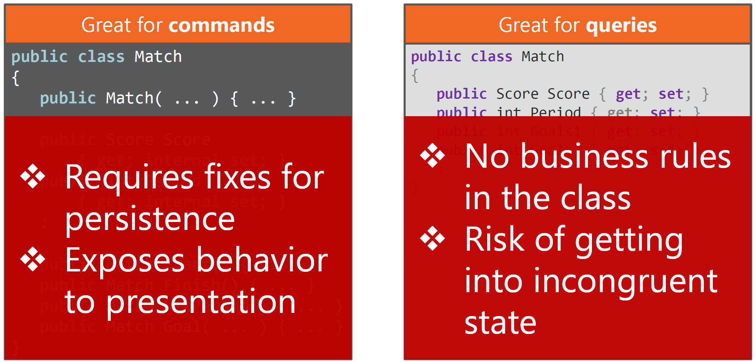
Singolo Model

Slide 7
Introducing CQRS
Command
Alter state
Doesn’t return data
Query
Return data
Doesn’t alter state
Notes:
Bertrand Meyer

Slide 8
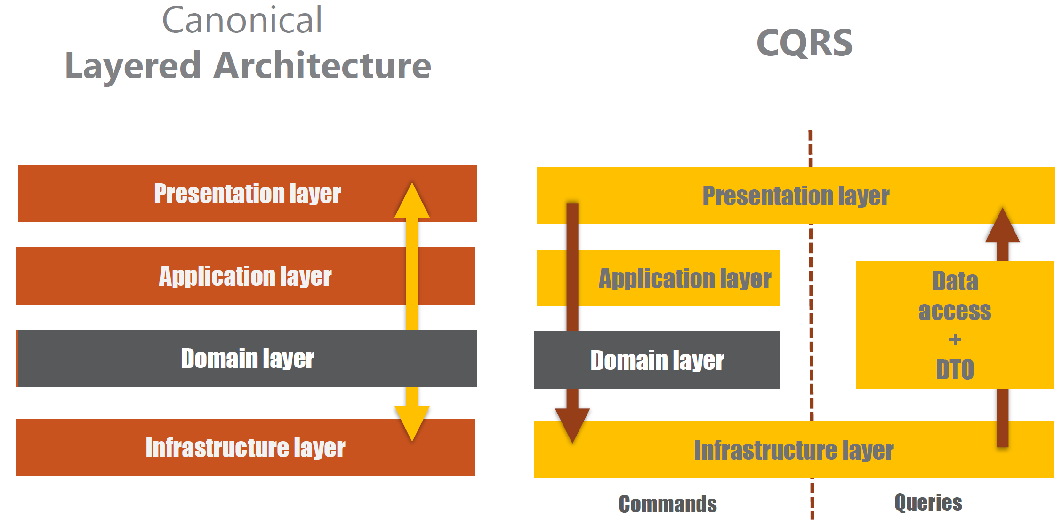

Slide 9
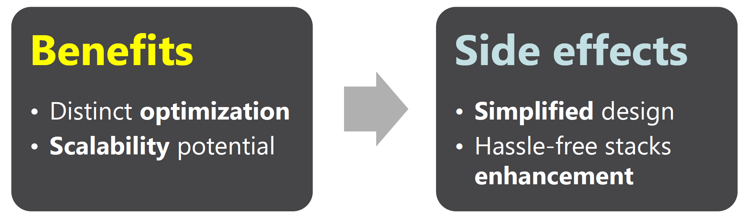
Benefici di CQRS

Slide 10
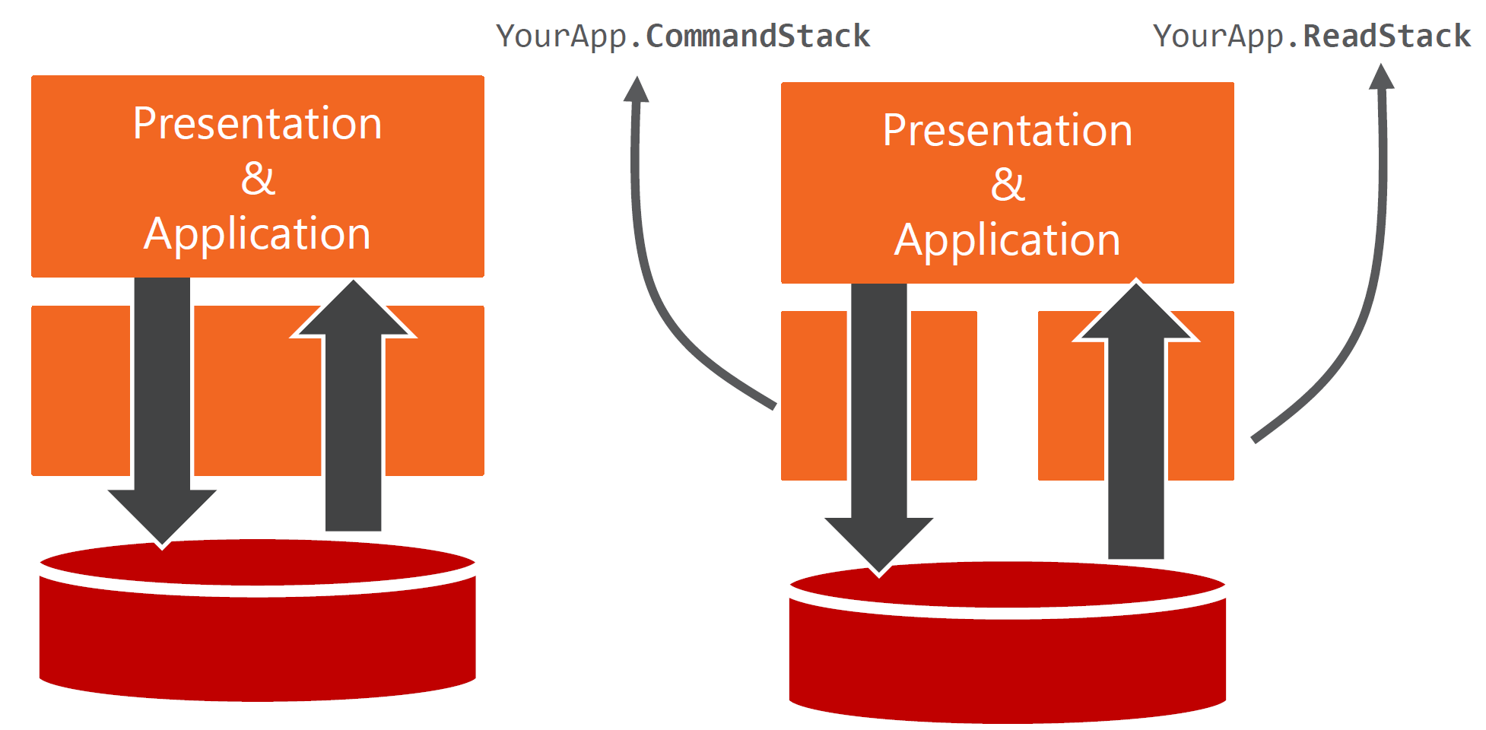
CQRS Flavors - 1

Slide 11
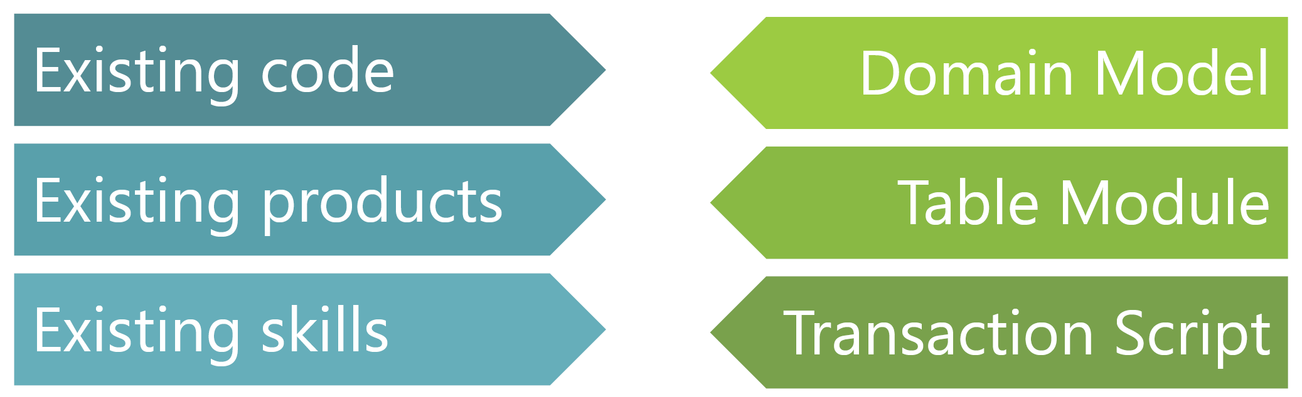
CQRS Flavors - 1

Slide 12
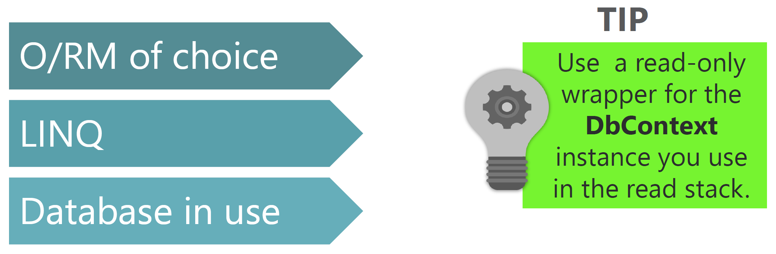
CQRS Flavor - 1

Slide 13
CQRS Flavor – 1 DEMO

Slide 14
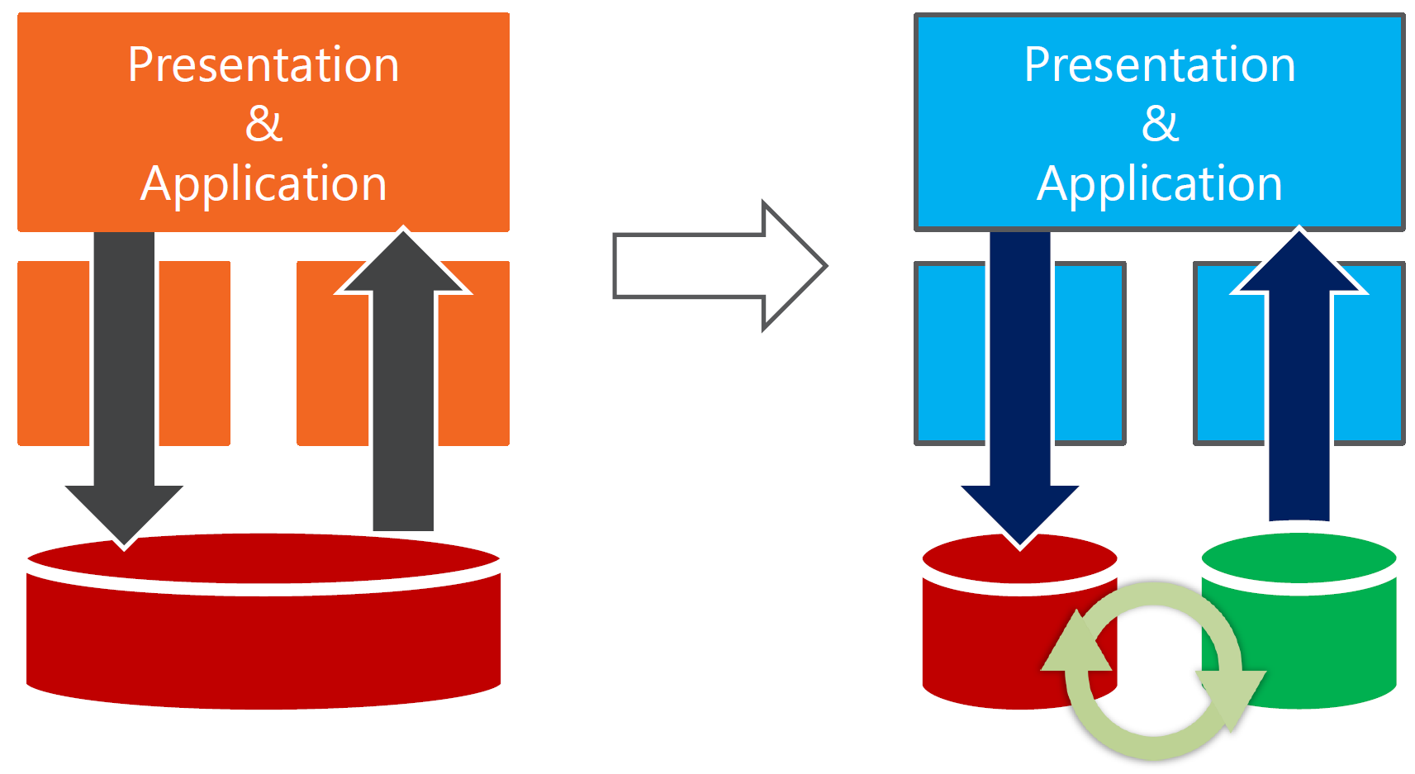
CQRS Flavors - 2

Slide 15
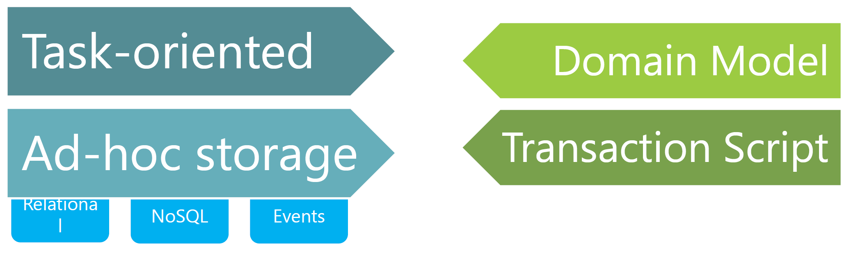
CQRS Flavors - 2
Command stack

Slide 16
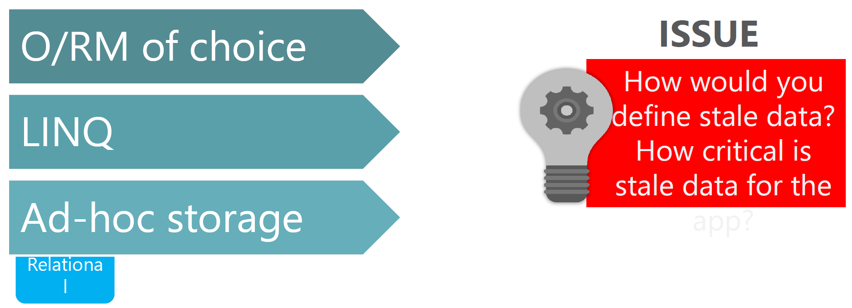

CQRS Flavors - 2

Slide 17
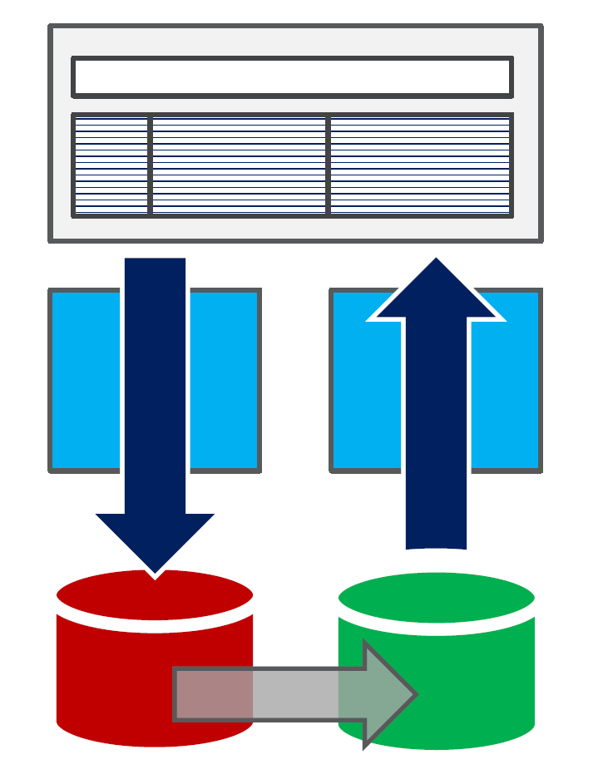
CQRS Flavors - 2
Storage

Slide 18
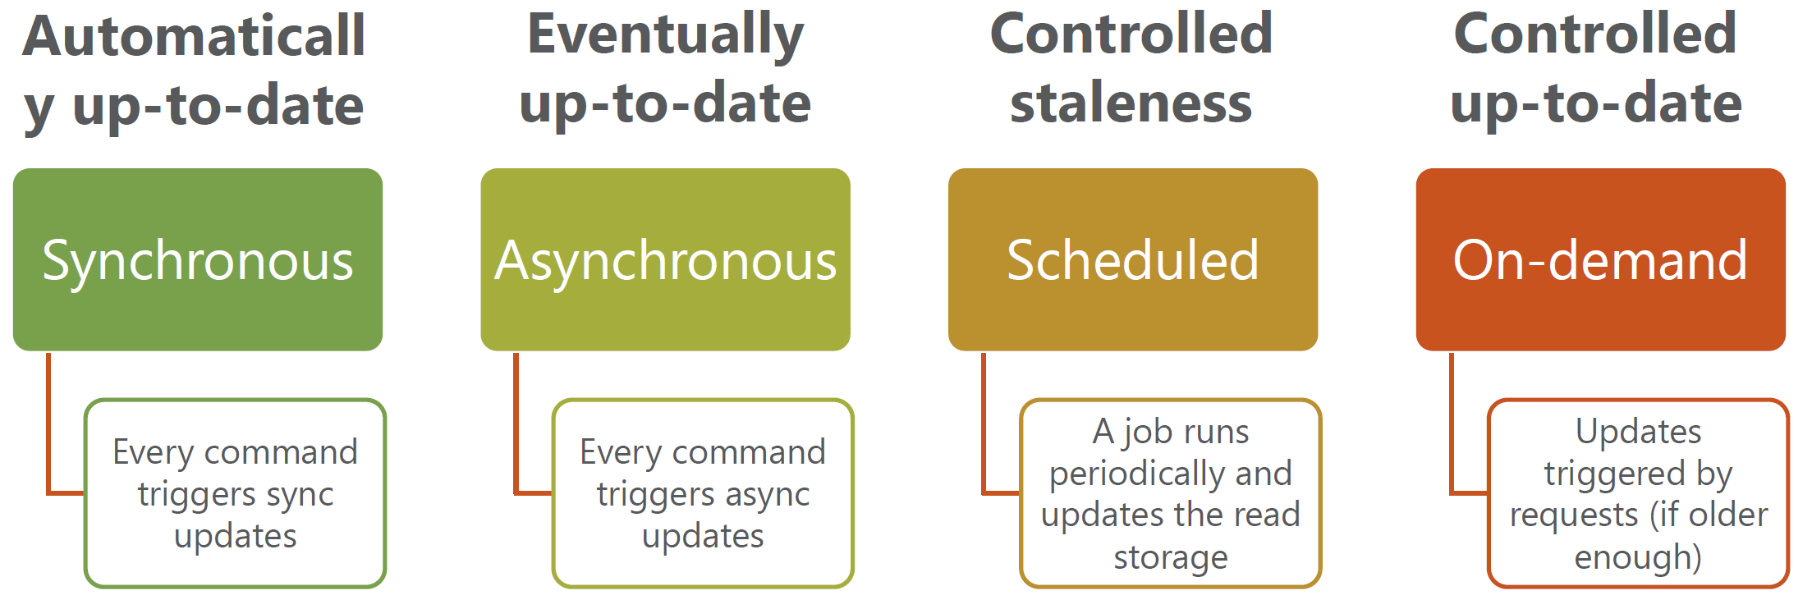
CQRS Flavors - 2

Slide 19
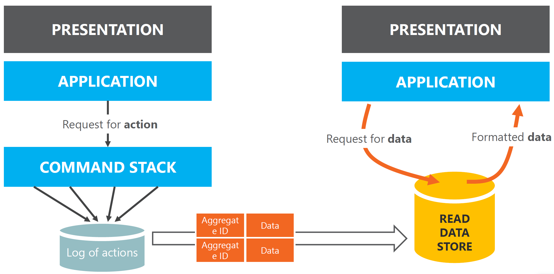
CQRS Flavors - 2

Slide 20
CQRS Flavor – 2 DEMO

Slide 21
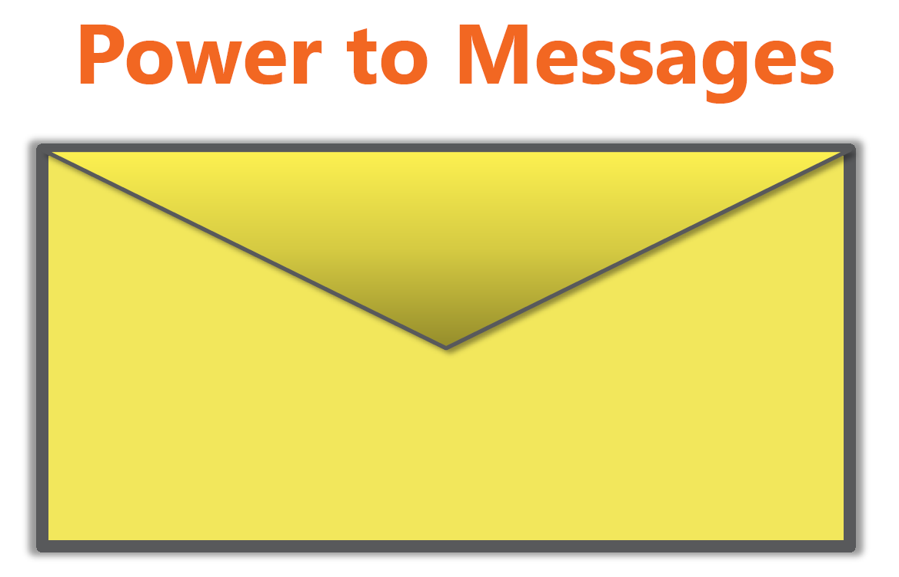
Message based architecture
Command or Event
Notes:
Command: is an action performed against the backend that the user requested.
Event: carries data and notifies of something is happened

Slide 22
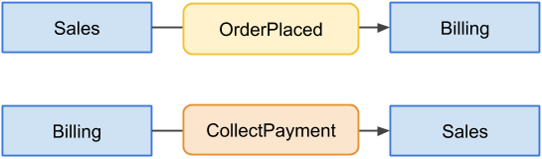
Events vs Commands
Events represent a past, something that already happened and can't be undone. Commands, on the other hand, represent a wish, an action in the future which can be rejected. An event has typically multiple consumers, but a command is addressed to only one

Slide 23
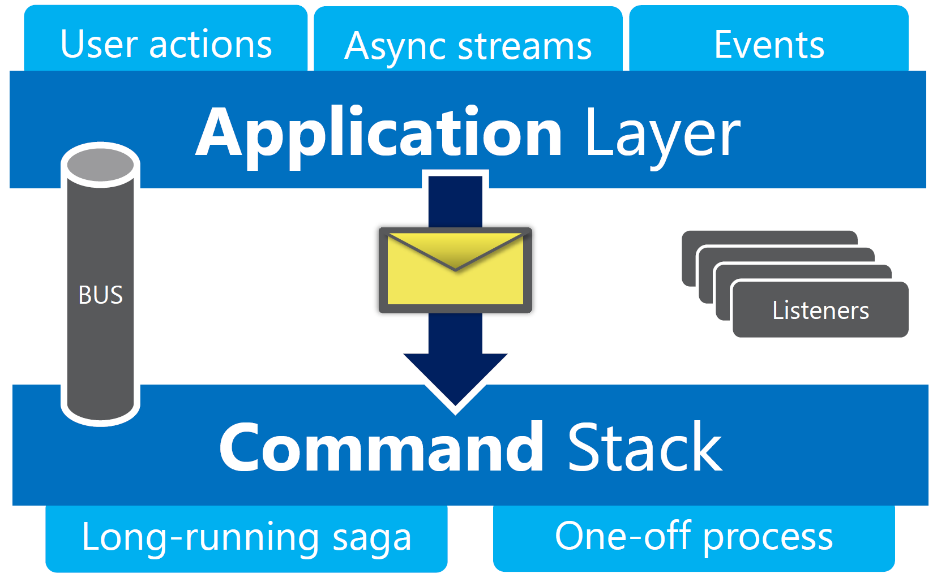
Message based architecture

Slide 24
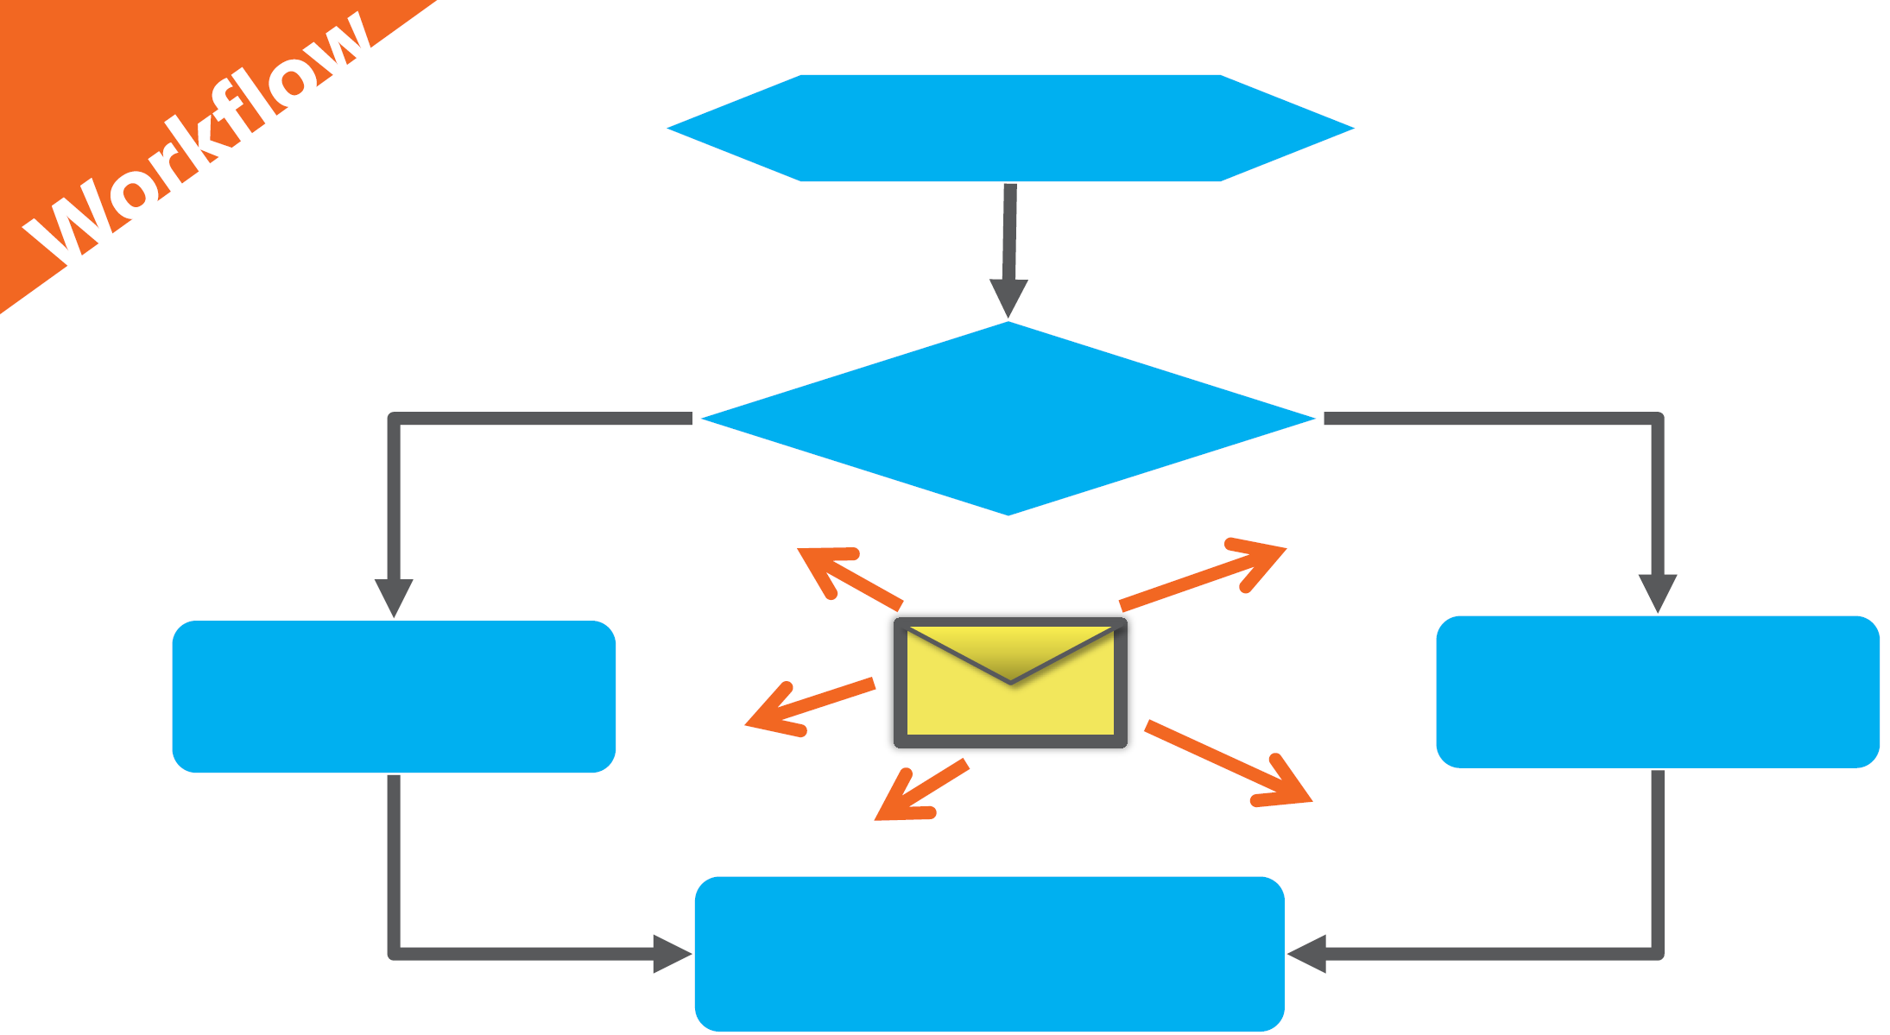
Message based architecture

Slide 25
CQRS Flavor – 2 DEMO

Slide 26
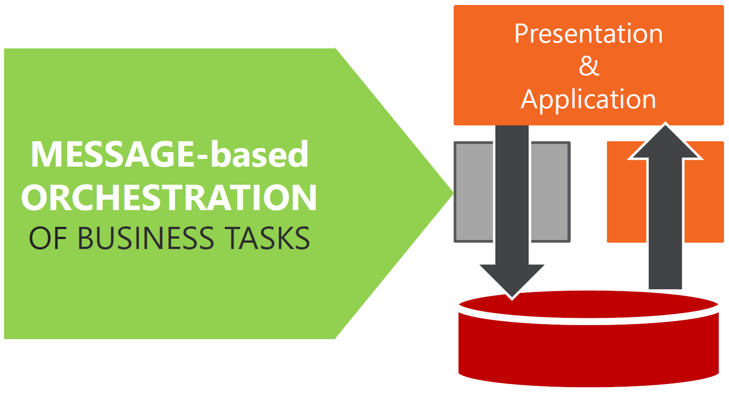
CQRS Flavors - 3

Slide 27
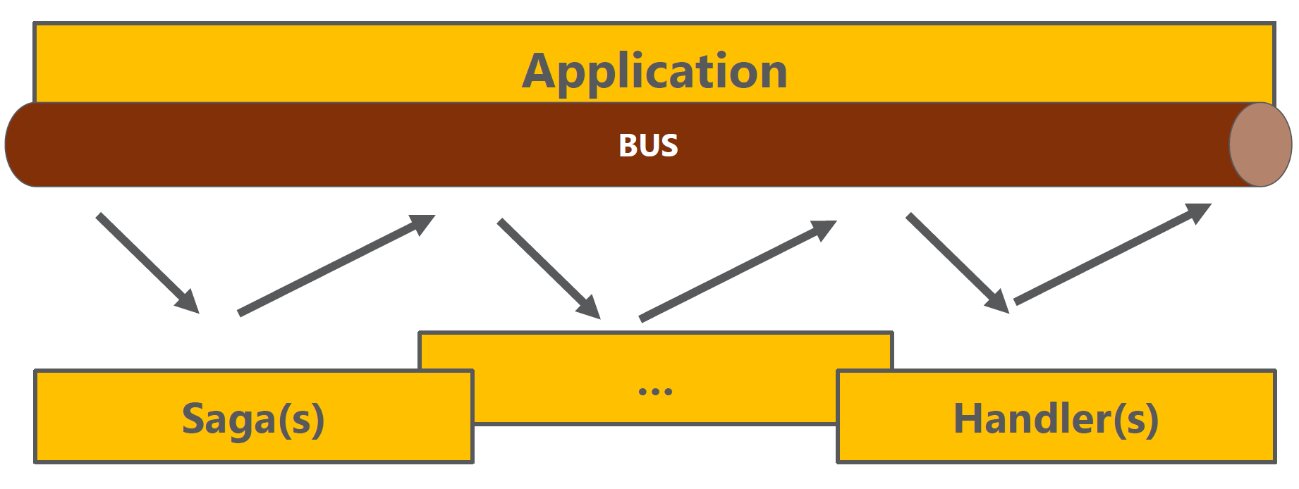
CQRS Flavors - 3
Command

Slide 28
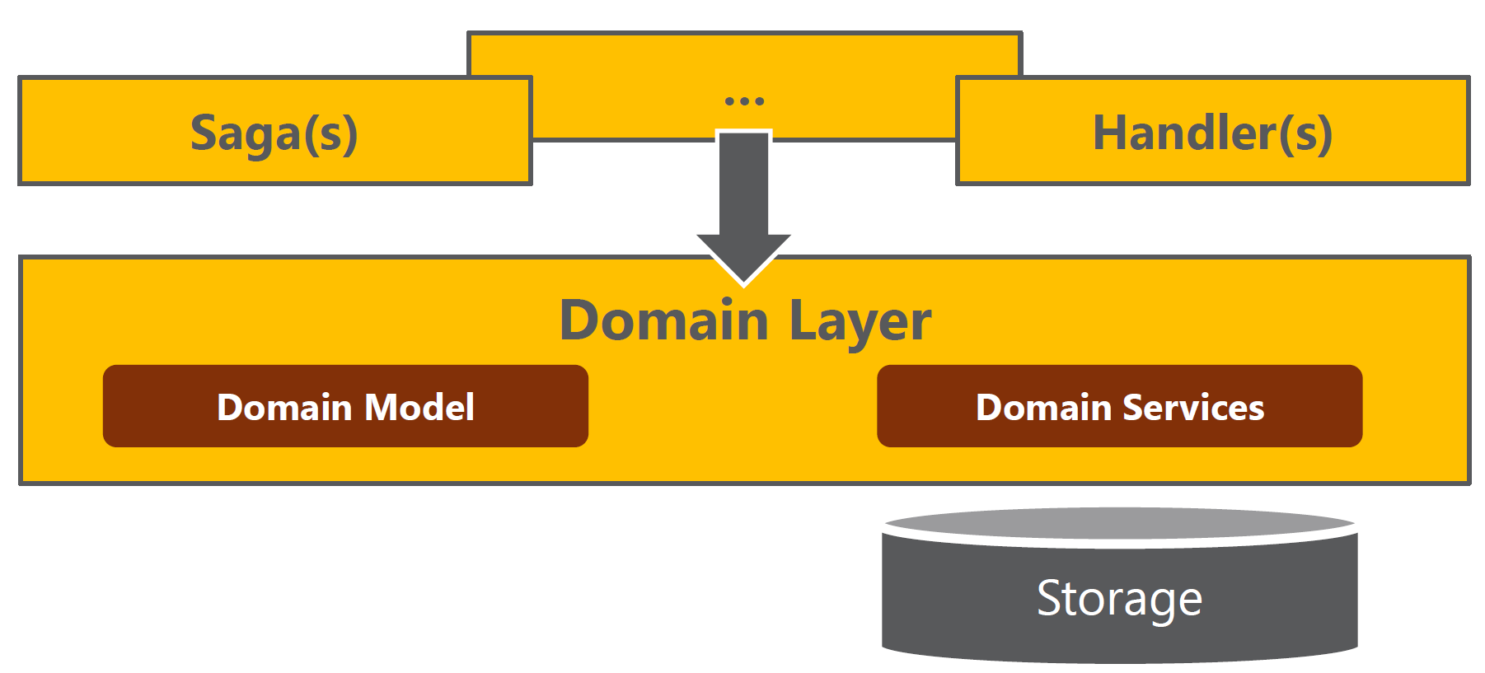
CQRS Flavors - 3
Command

Slide 29
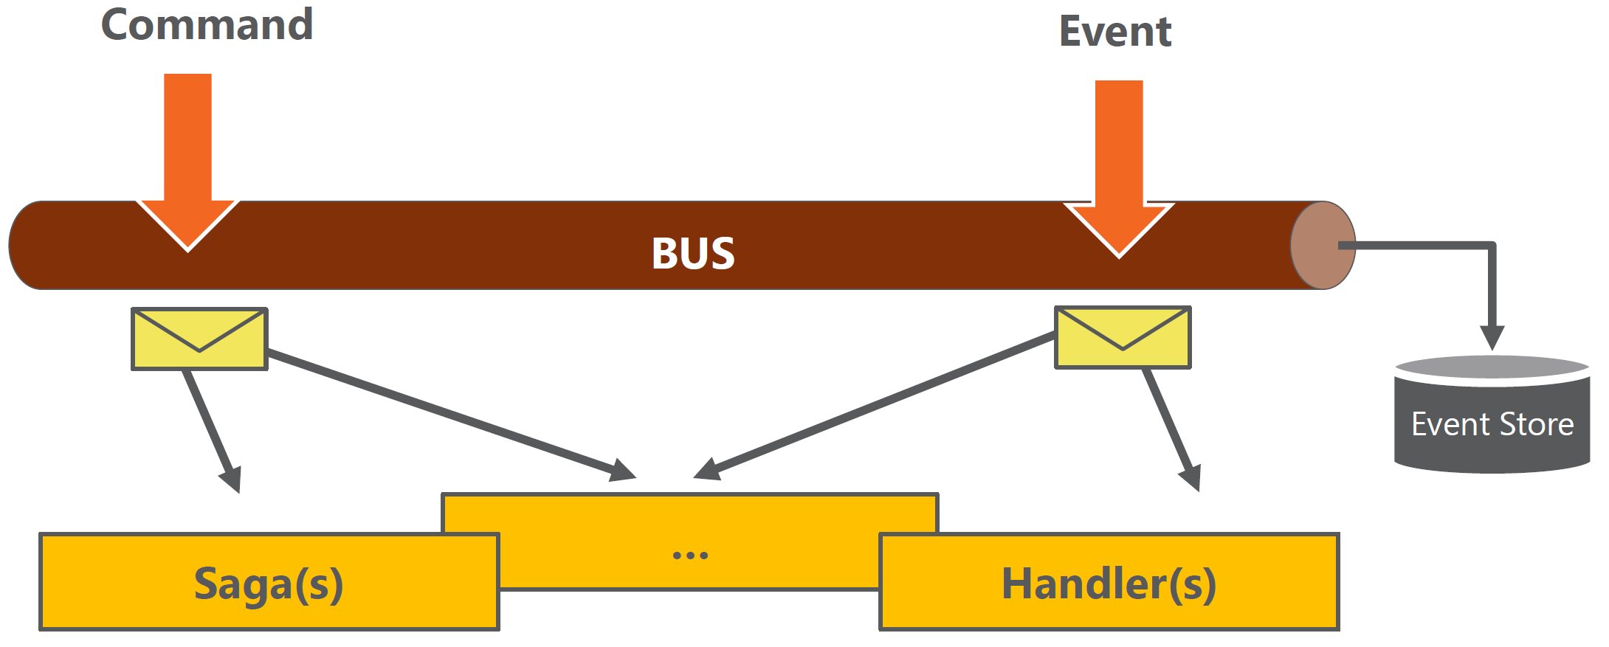
CQRS Flavors - 3
Notes:
Event-Sourcing
Un evento viene prima salvato nell’event store

Slide 30
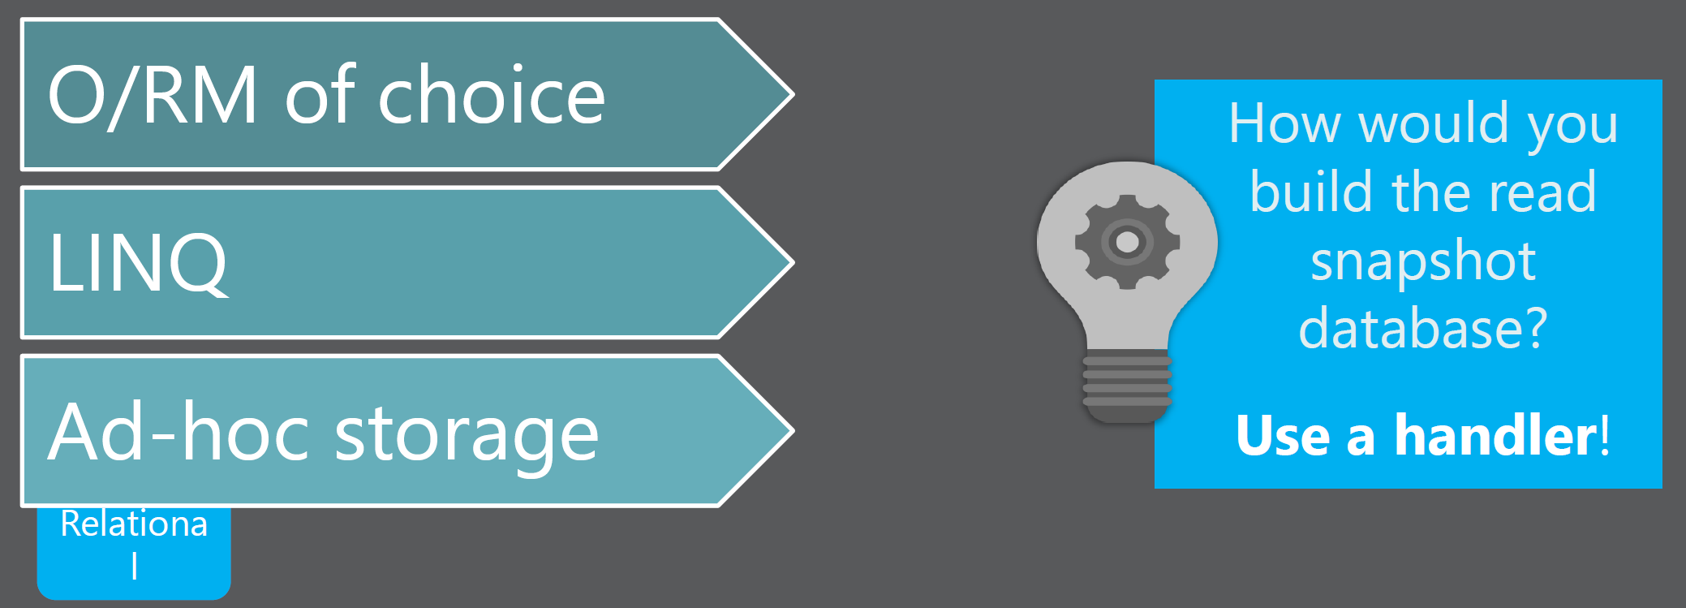
CQRS Flavors - 3
Read

Slide 31
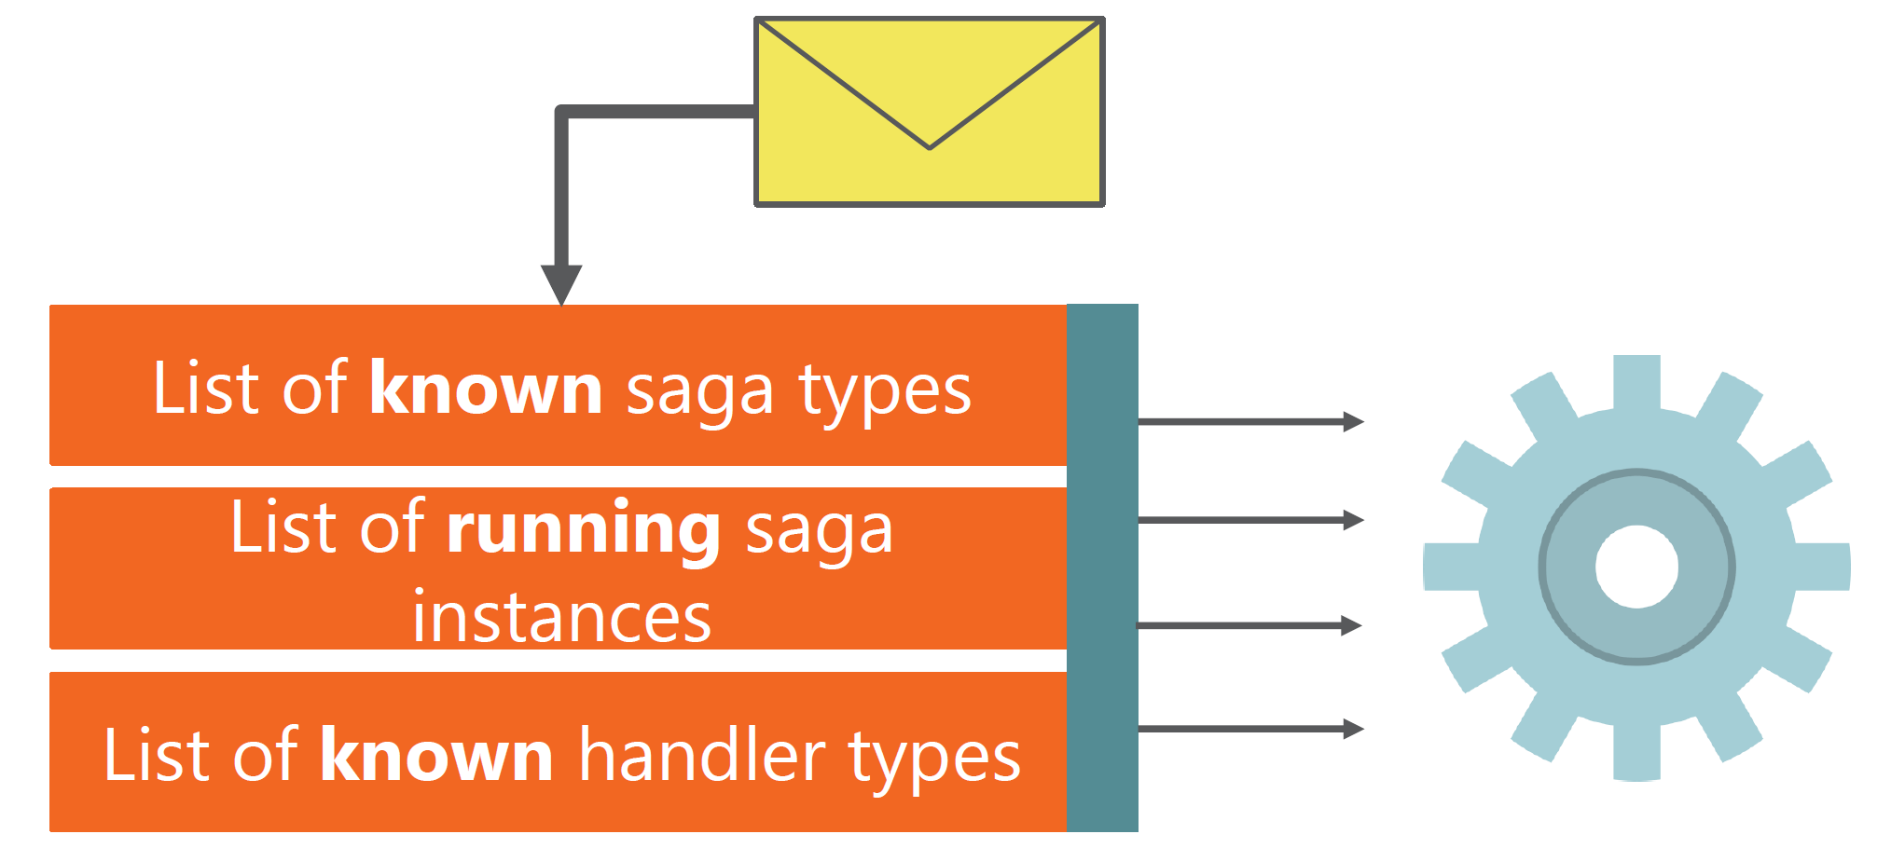
CQRS Flavors - 3
BUS

Slide 32
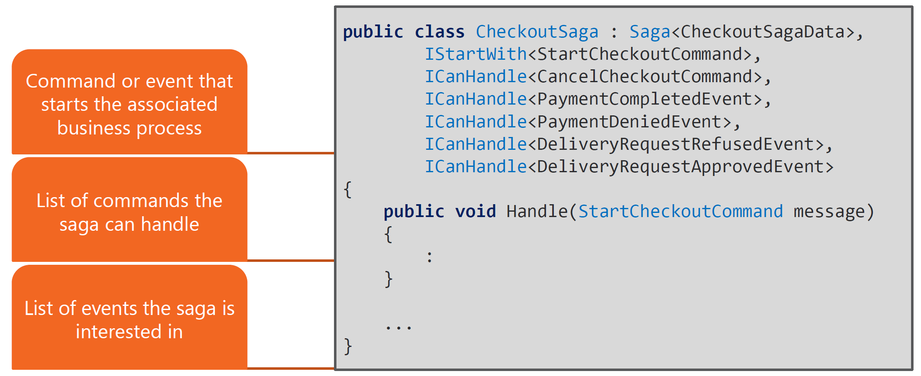
CQRS Flavors - 3
SAGA

Slide 33
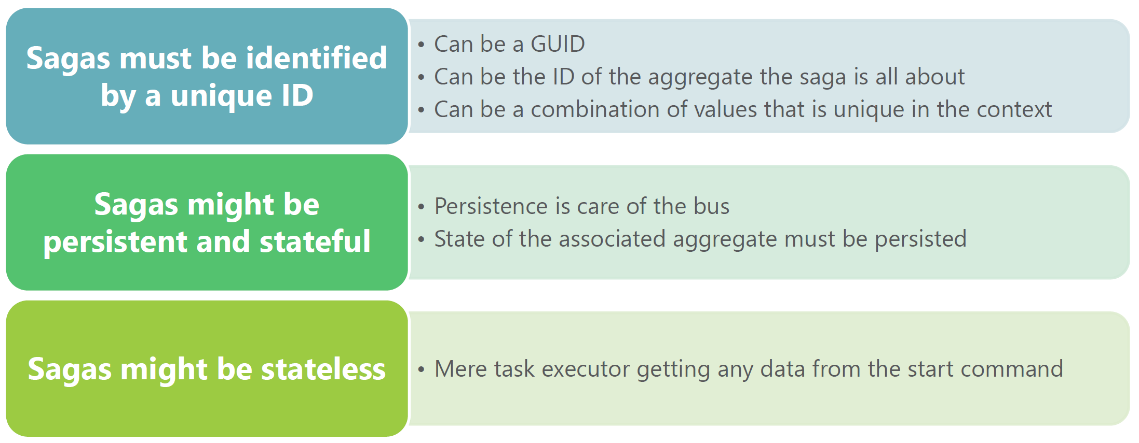
CQRS Flavors - 3
SAGA

Slide 34
CQRS Flavor – 3 DEMO

Slide 35
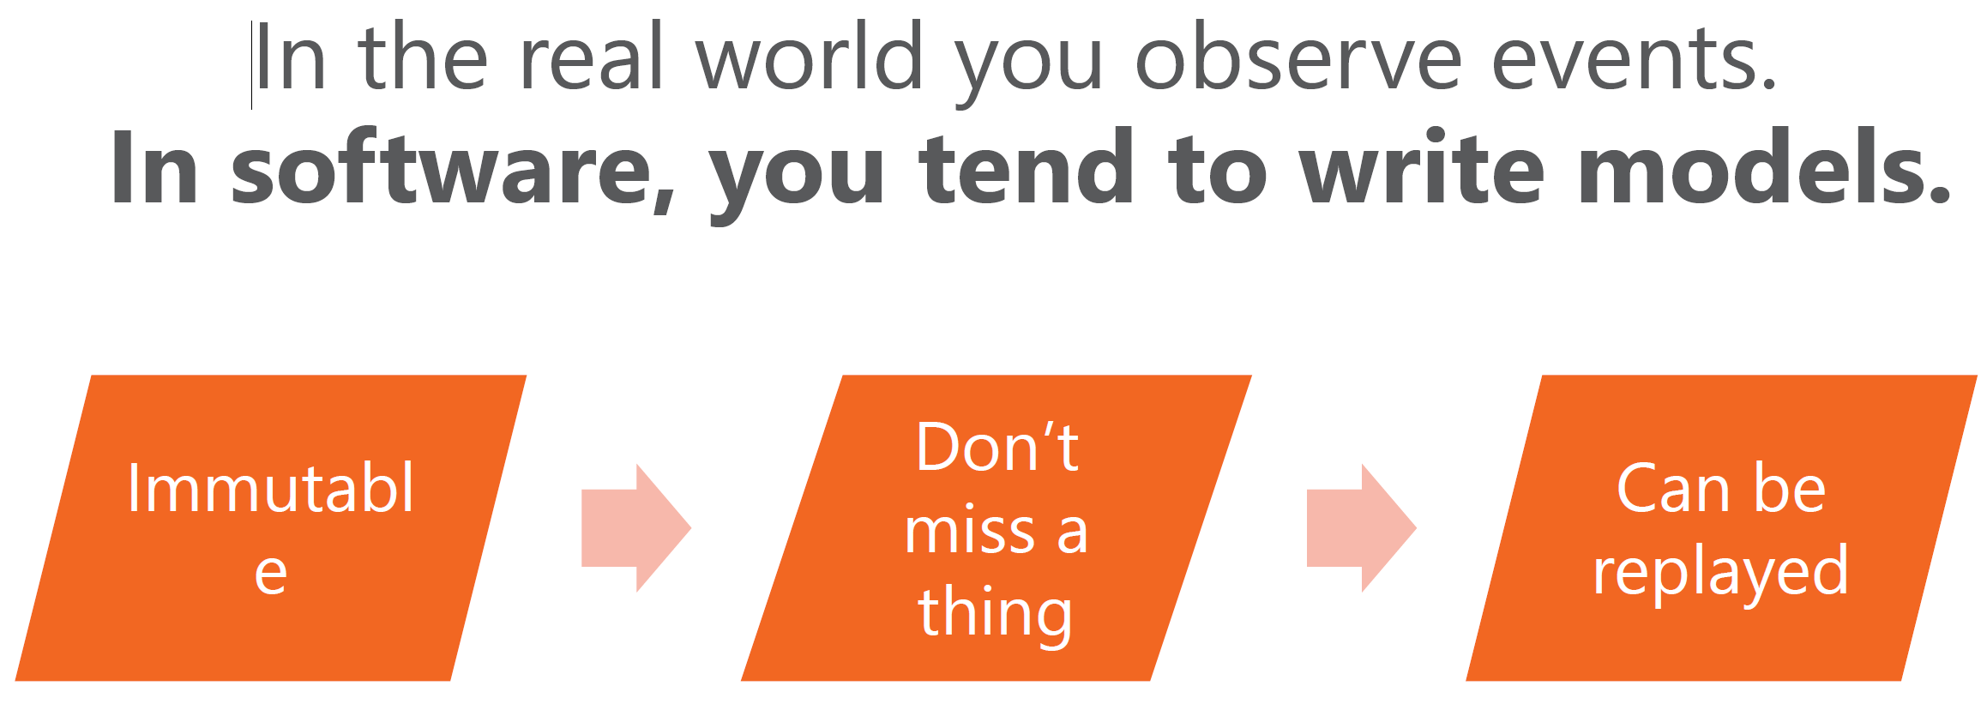
More about events

Slide 36
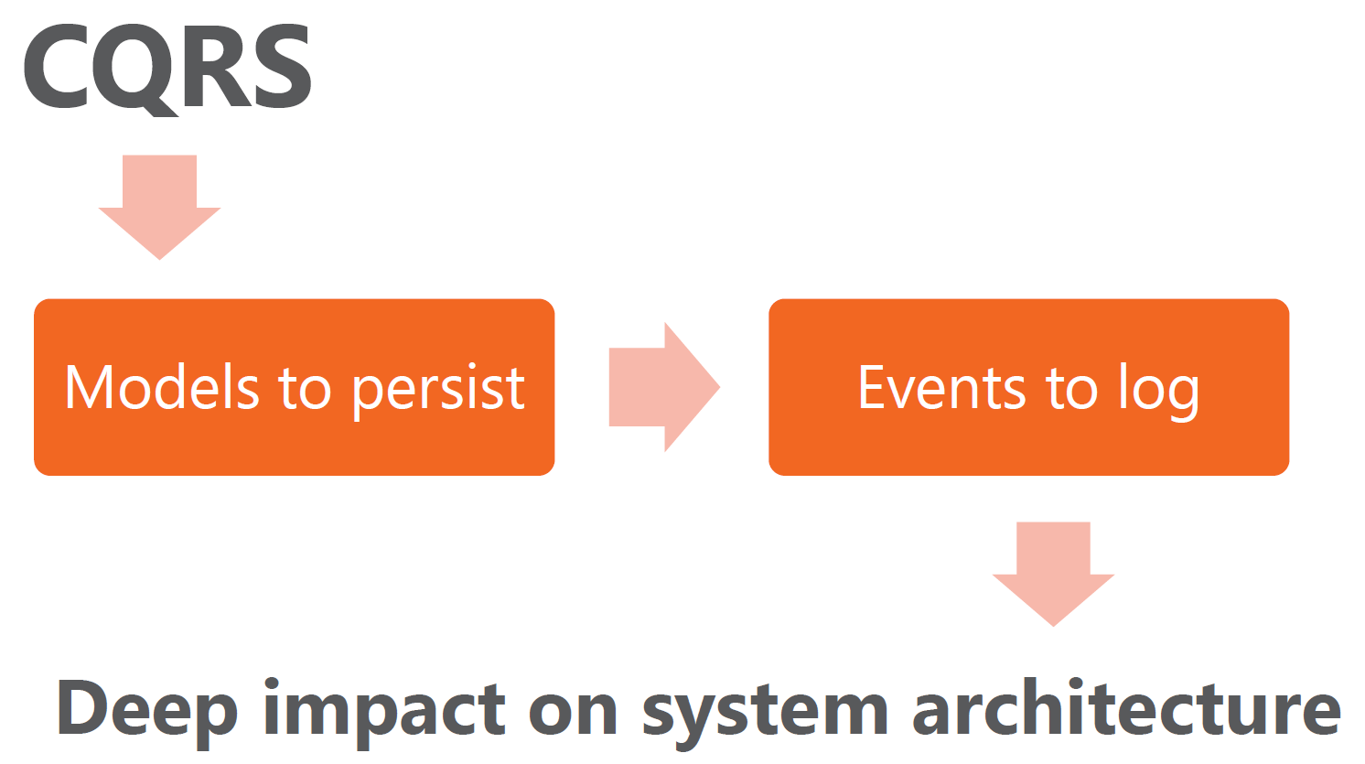
CQRS is the starting point

Slide 37
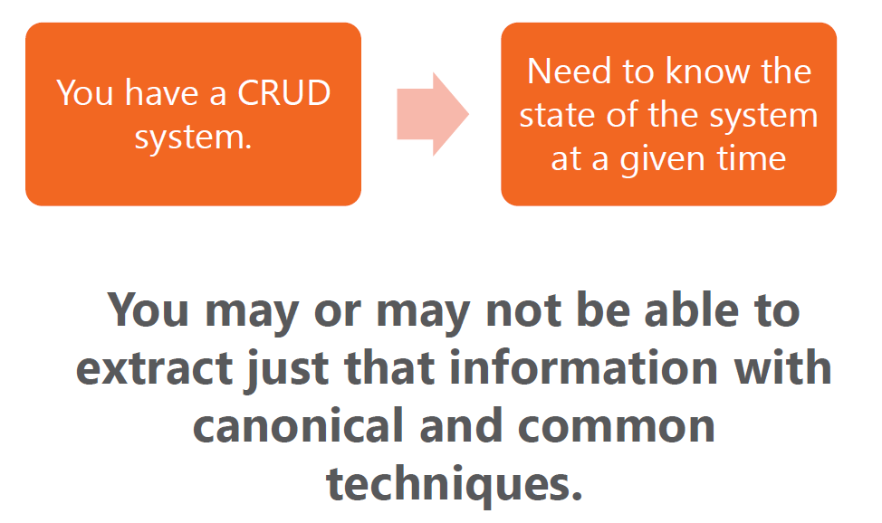
Events are also for the common application

Slide 38
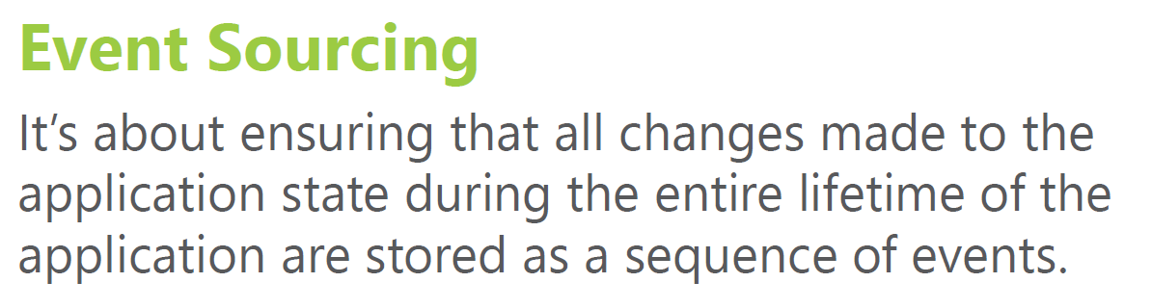
What is Event Sourcing?

Slide 39
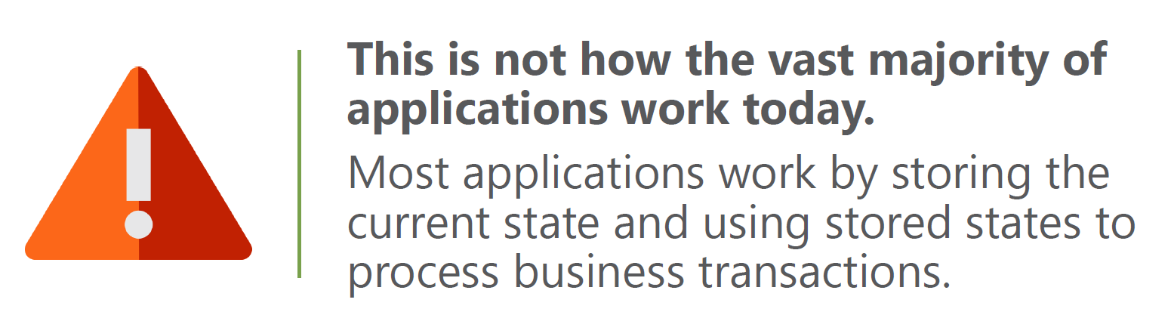
What is Event Sourcing?

Slide 40
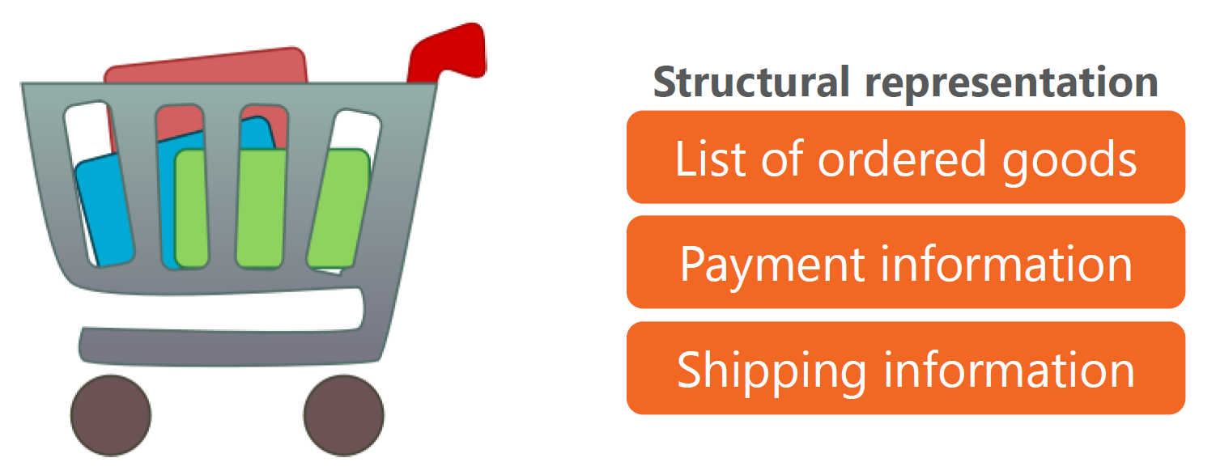
A shopping cart example

Slide 41
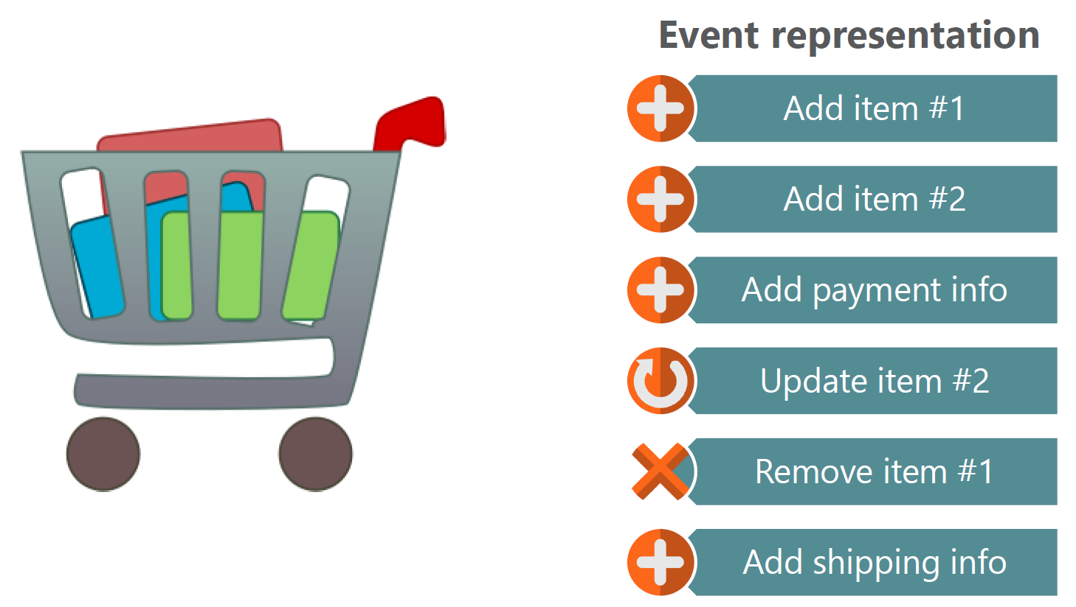
A shopping cart example

Slide 42
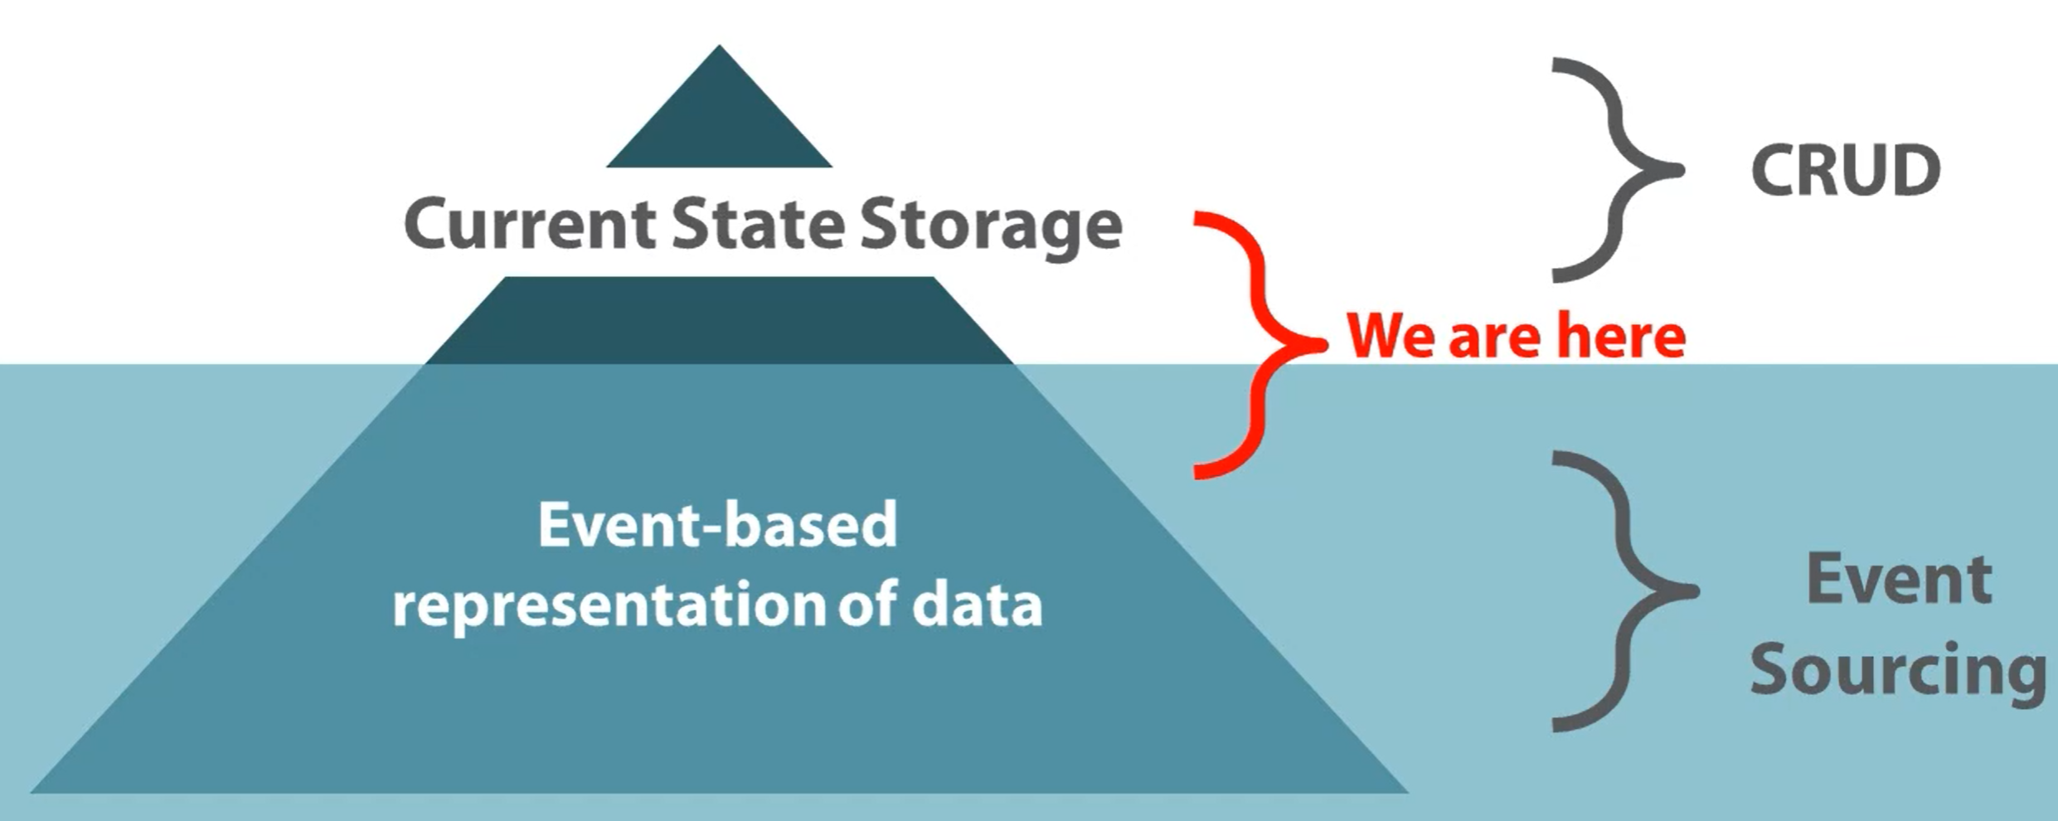
Current state vs Event Sourcing

Slide 43
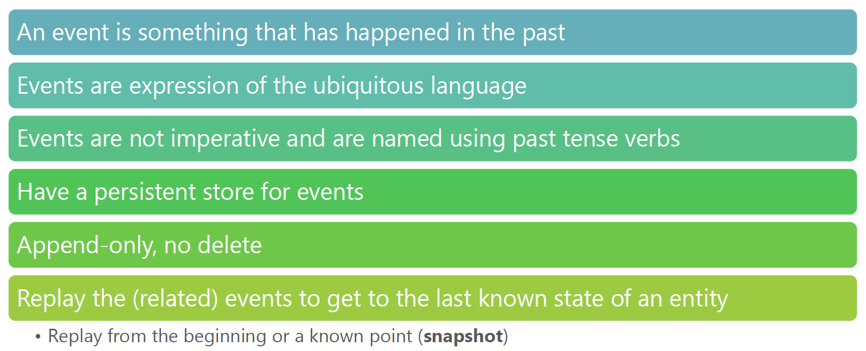
Key aspects of Event Sourcing

Slide 44
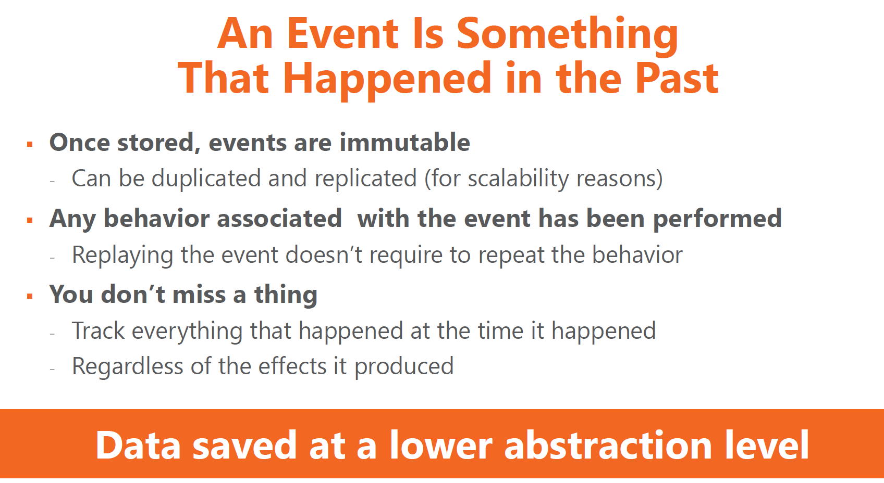
Key aspects of Event Sourcing

Slide 45
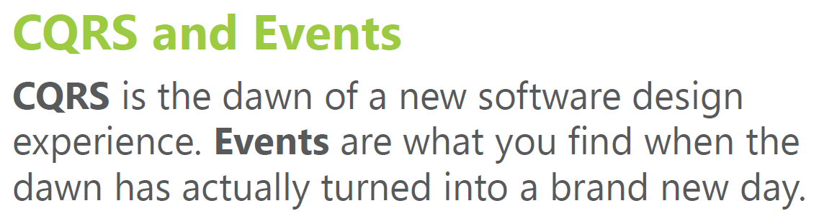
CQRS is not just for a few apps either

Slide 46
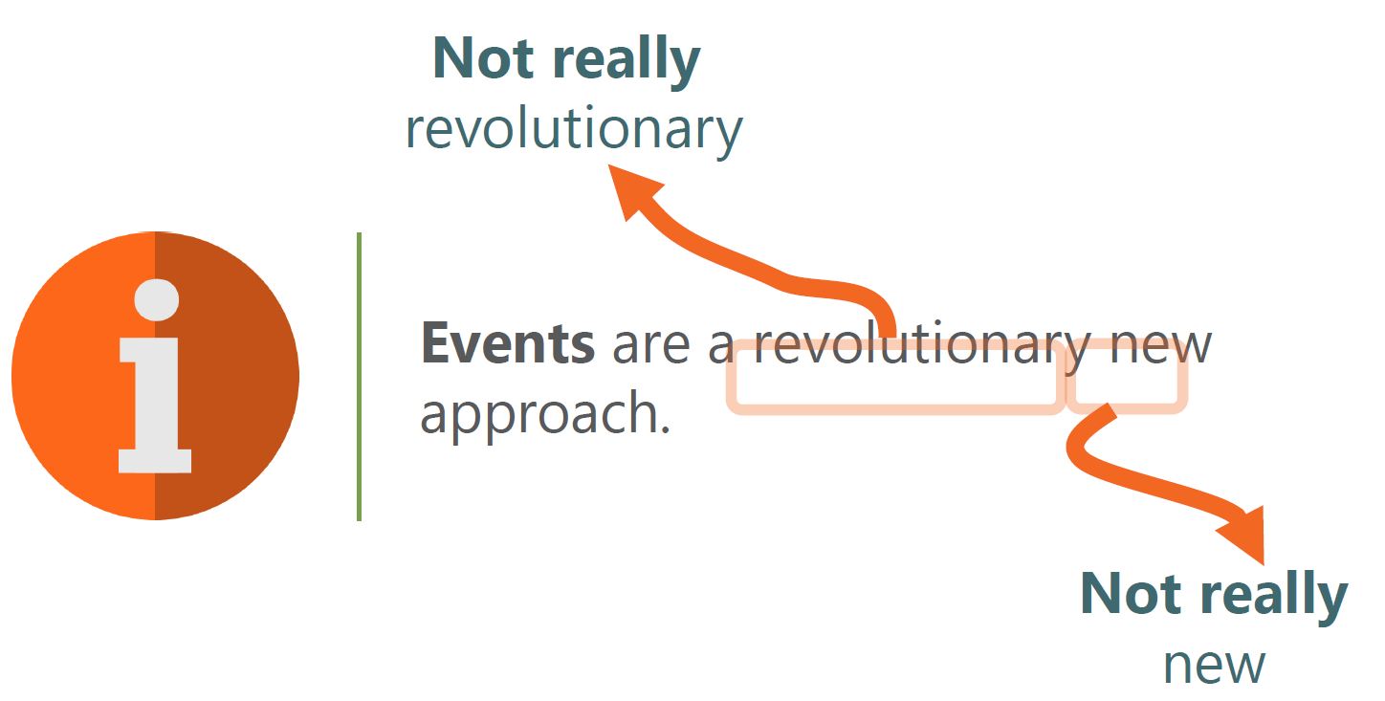
A revolutionary approach

Slide 47
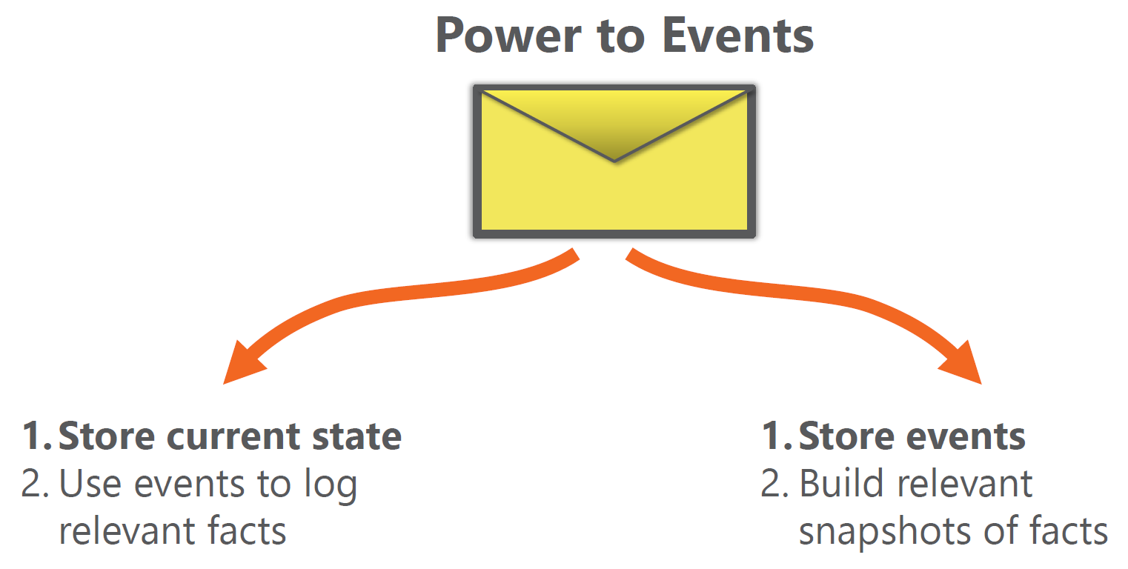
Power to Events!

Slide 48
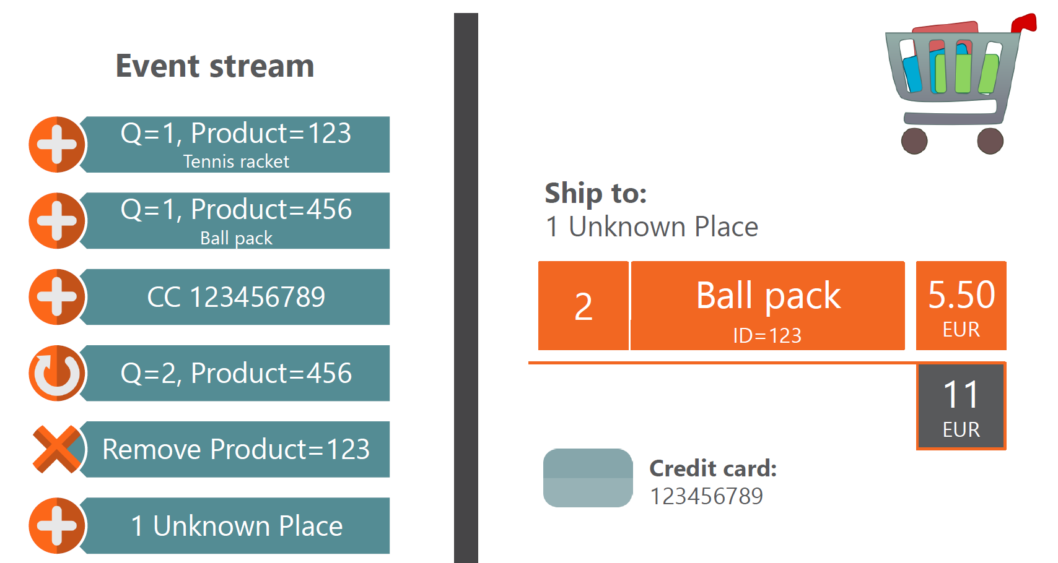
Events: a real example

Slide 49
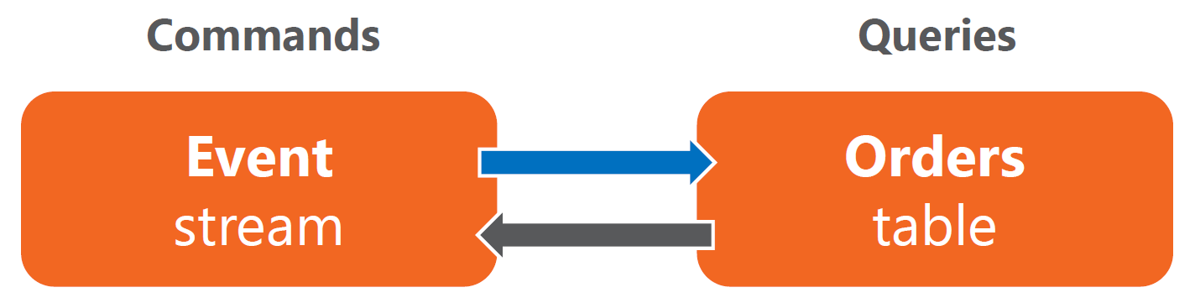
Do I need Event Sourcing?
Is it important to track what was added and then removed?
Is it important to track when an item was removed from cart?

Slide 50
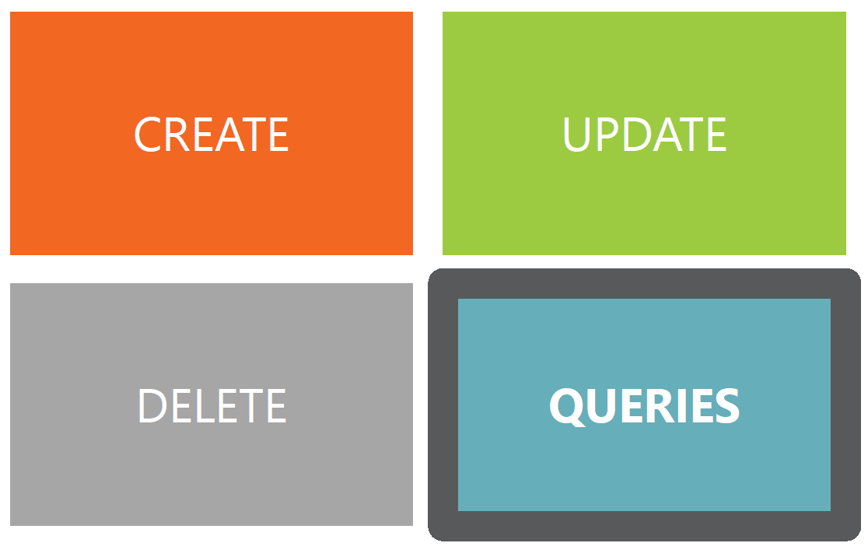
Pillars of Event Sourcing

Slide 51
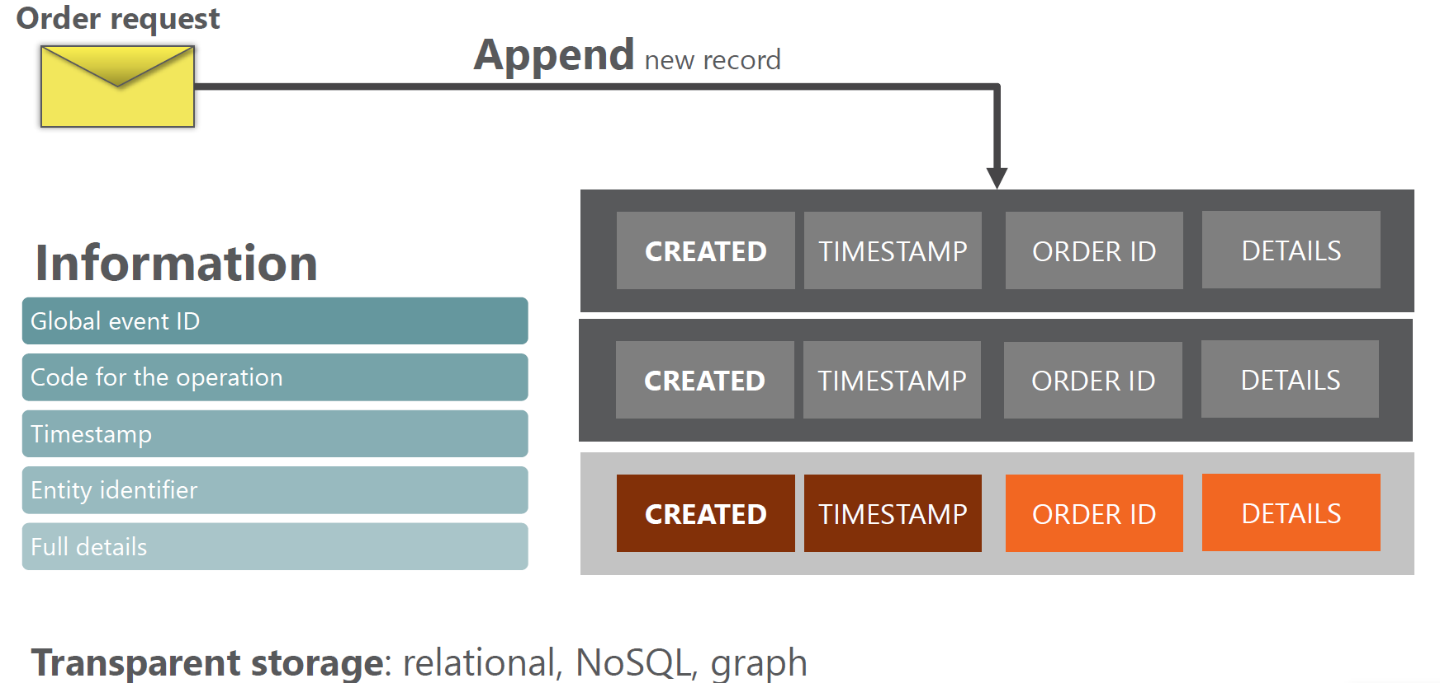
An example of Create

Slide 52
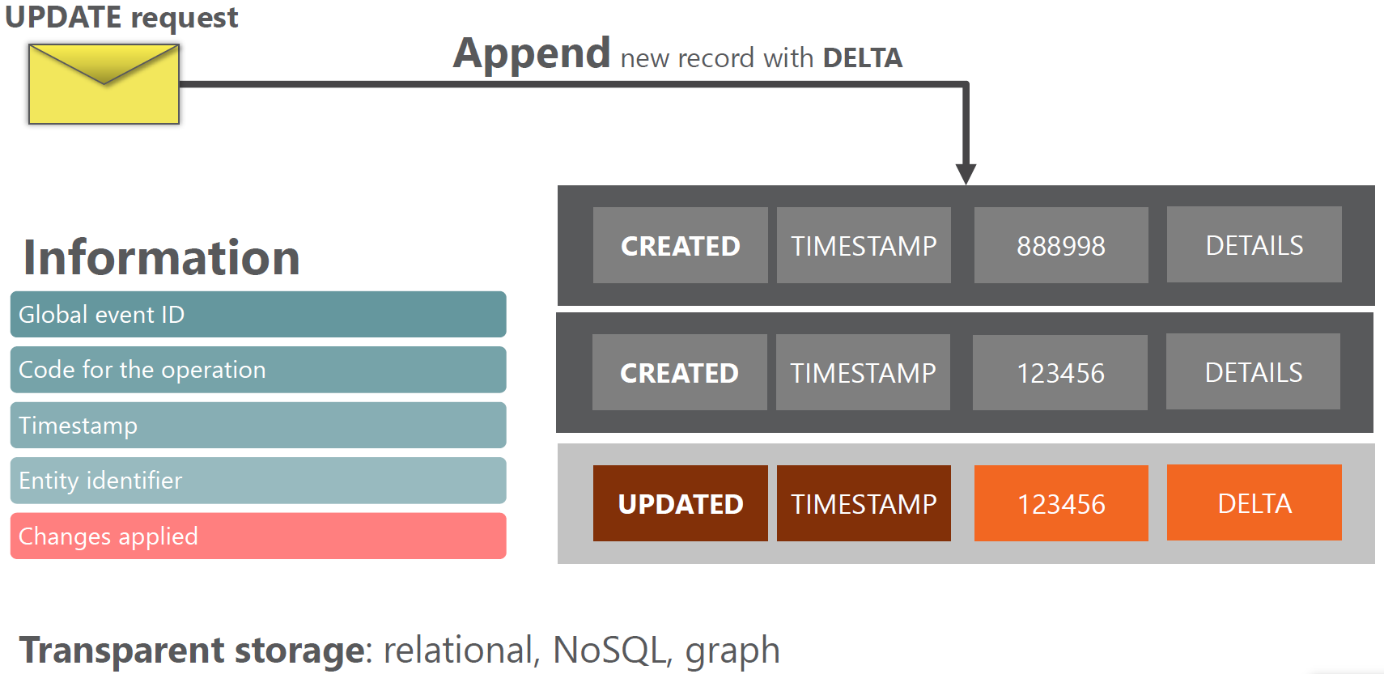
An example of Update

Slide 53

An example of Delete

Slide 54
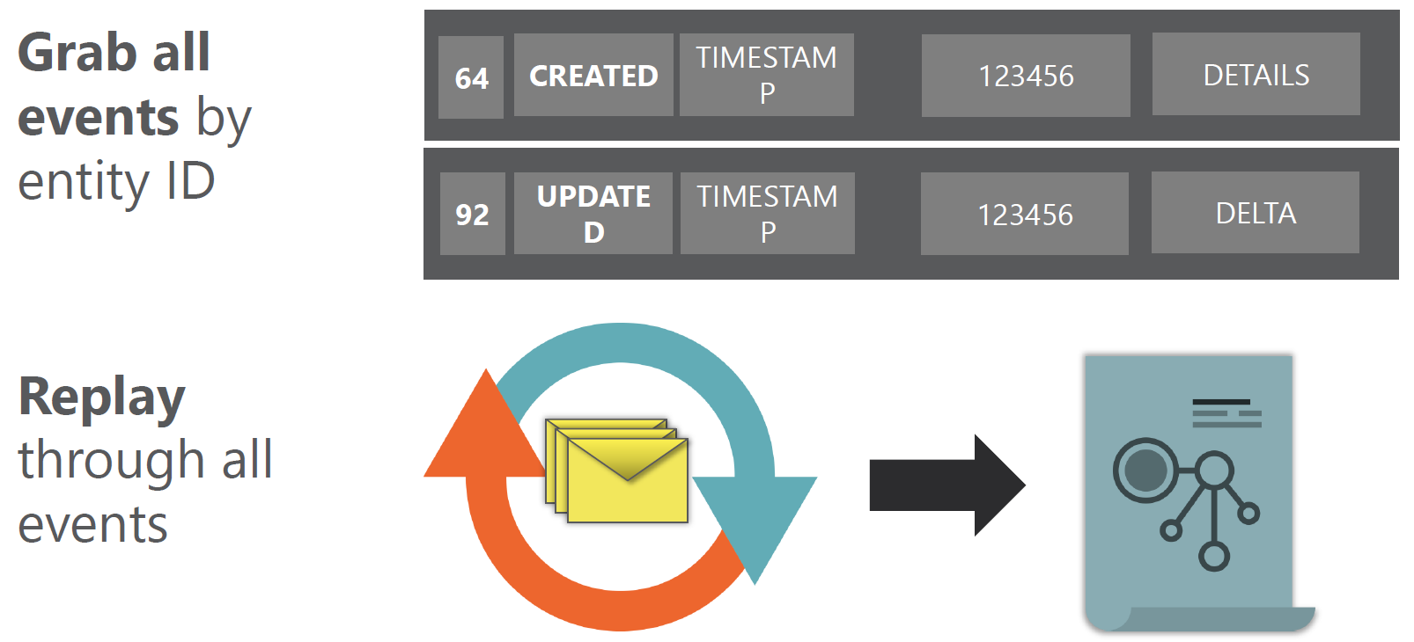
Query Operations

Slide 55
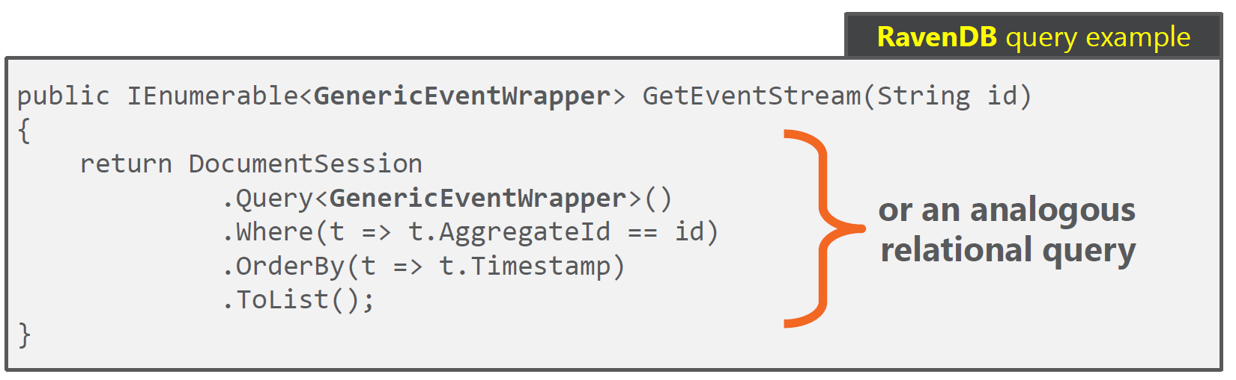
Replay of Events
Full or Partial stream of Events

Slide 56
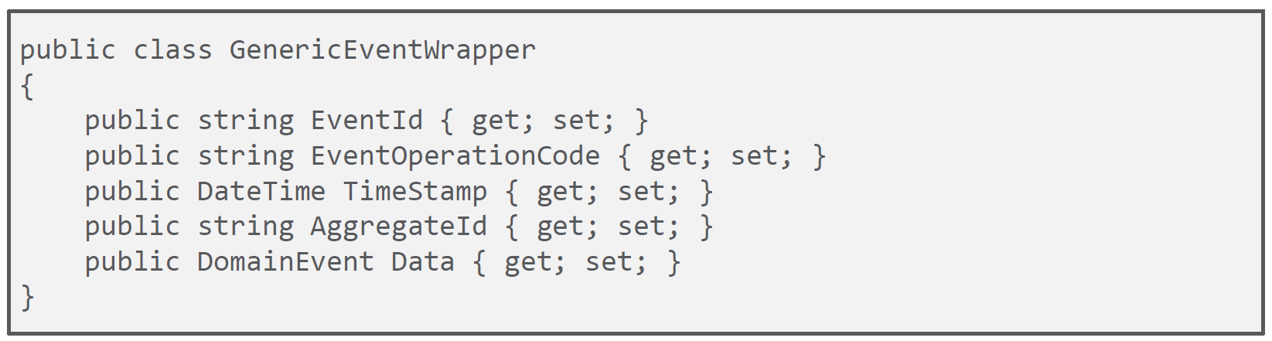
Replay of Events

Slide 57
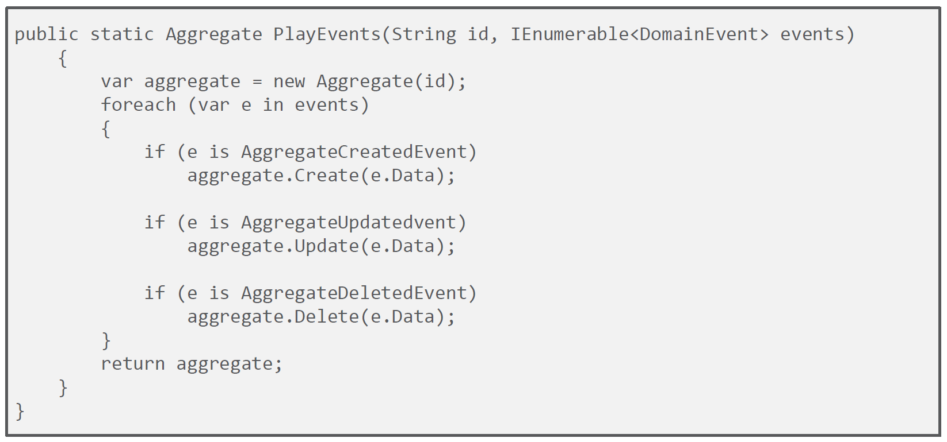
Replay of Events

Slide 58
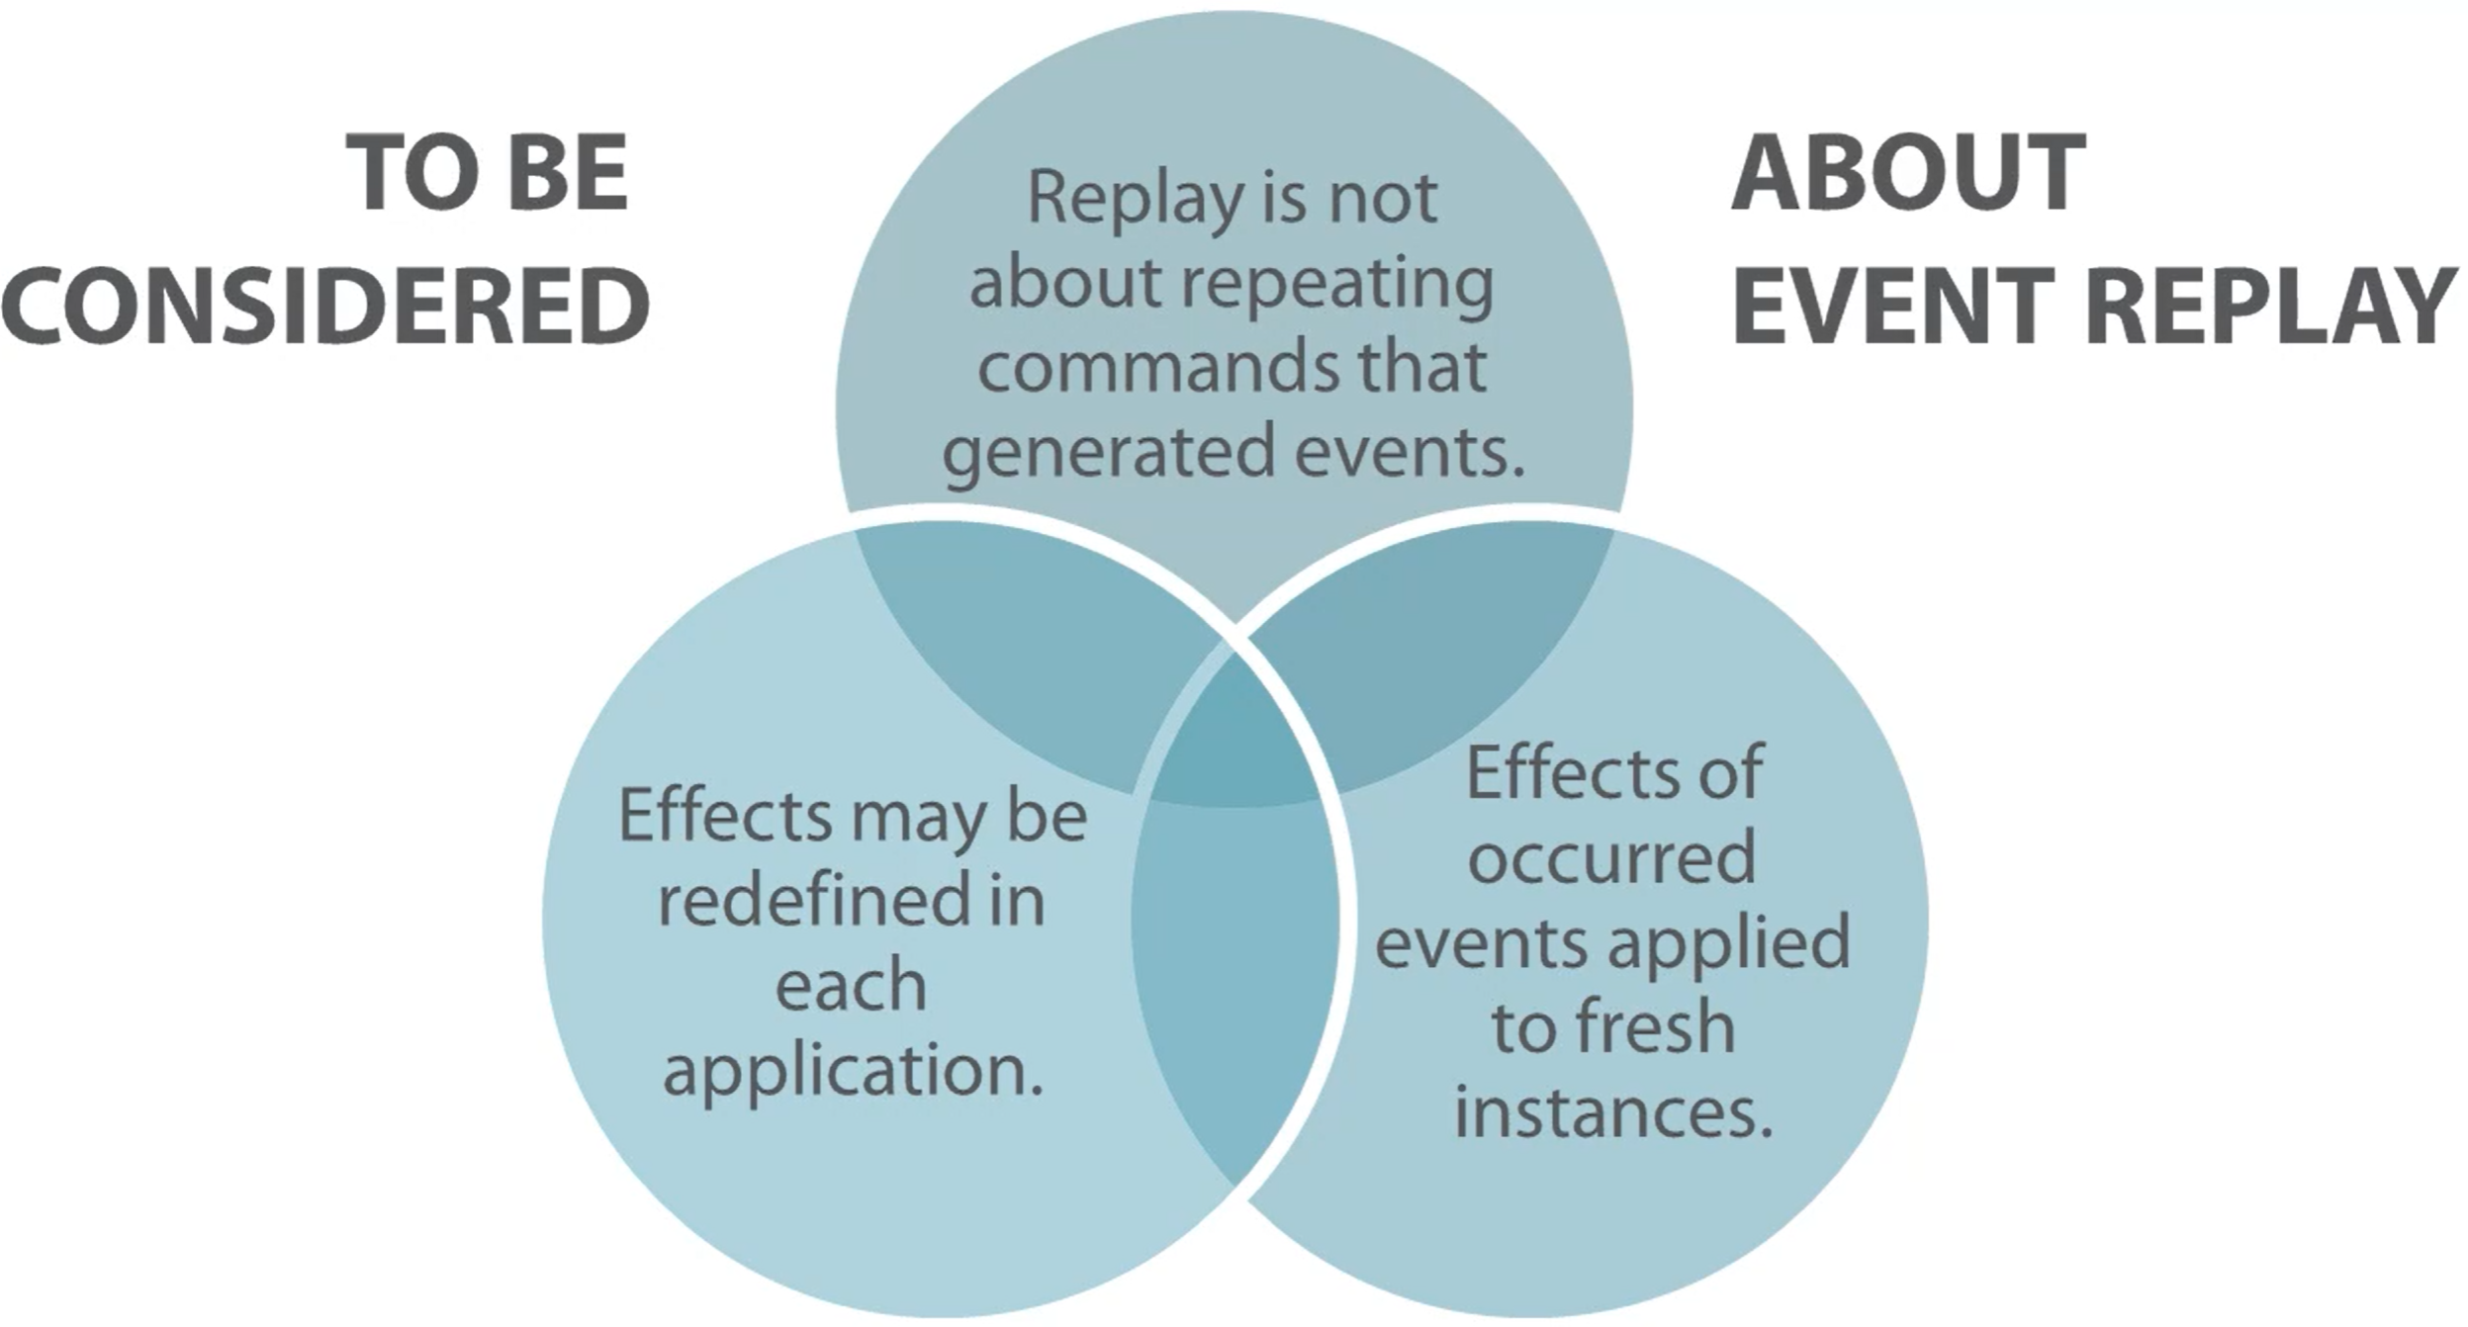
Replay of Events

Slide 59

Replay of Events

Slide 60

Replay of Events

Slide 61

Event Store

Slide 62

Event Store Operations

Slide 63

Event Store Subscriptions

